Slide 1
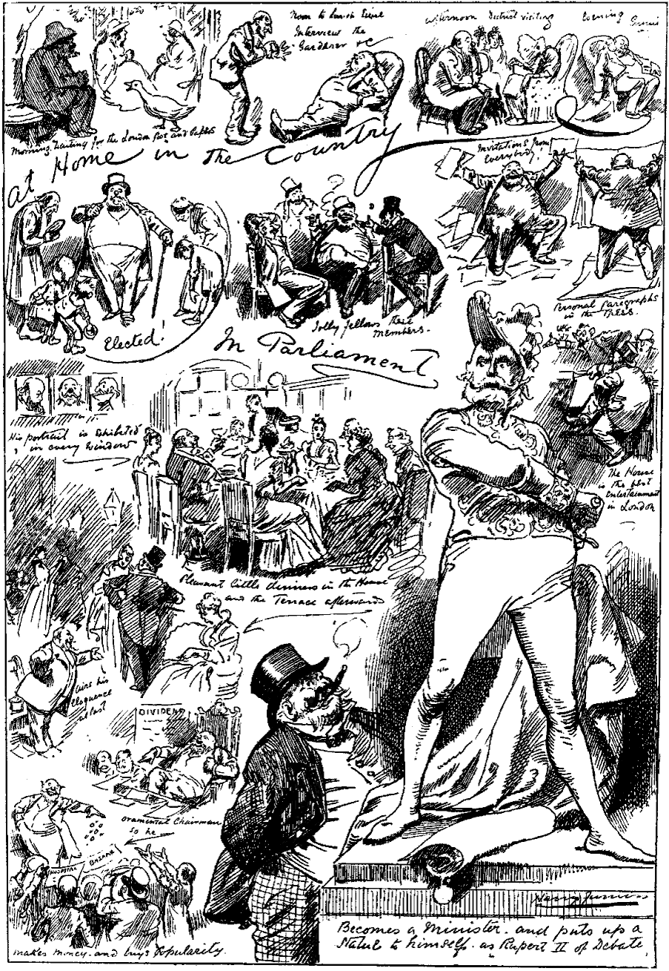
THE GERMAN CONFEDERATION
1815-1848.
Why was German Unification unlikely in 1815?
The German Confederation was set up at the Congress of Vienna (1815) with 39 separate states all being controlled by separate rulers.
The Diet (Parliament) of the Confederation included representatives from each state chosen by the individual princes.
It had little power as there was unanimous verdicts and no army or civil service.

Slide 2
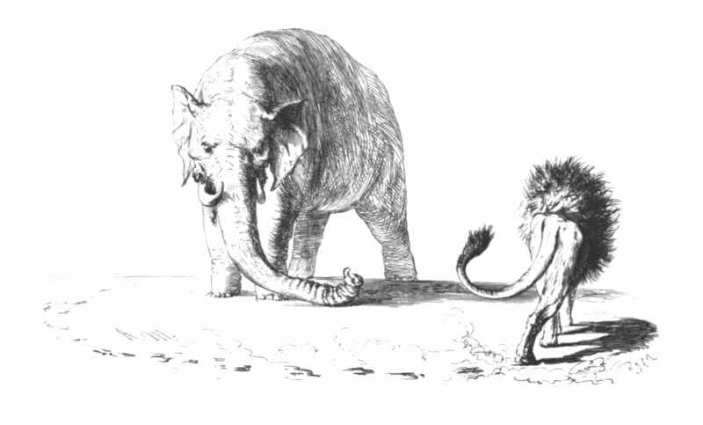
THE GERMAN CONFEDERATION
1815-1848.
Why was German Unification unlikely in 1815?
‘Peaceful Dualism’ meant that Austria and Prussia dominated and shared the control of Germany.
The southern catholic states tended to look towards Austria for leadership and the northern, protestant states to Prussia.

Slide 3
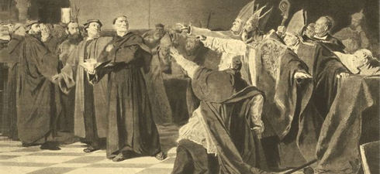
THE GERMAN CONFEDERATION
1815-1848.
Why was German Unification unlikely in 1815?
The was cultural, religious and national disunity. Some non-Germans were part of the Confederation; some Confederation states were ruled by non-Germans and parts of the Habsburg Empire was outside of the Confederation.
The Junkers (aristocratic landowners) dominated society. There was little industry or large towns.

Slide 4
THE GERMAN CONFEDERATION
1815-1848.
Even those who supported changes in how Germany was governed were divided!
Liberals:
promoted the idea of an elected parliament to pass laws and run the country, rather than power held solely by an absolute monarch. They also championed freedom of speech and an end to censorship.
Nationalists
Promoted the belief that ones nationality and language was the most important ingredient in forming a country. Often the idea is held that ones country supersedes all others and outside interests are ignored
For the most part, until 1848 Liberalism was the most important ideological movement resisting the status quo of a divided and disparate Germany.
However, Liberals were more focused on championing the cause of constitutional reform in the many German states as opposed to ripping up the map and uniting Germany as one political unity.
Nationalism tends to thrive more under a state of war or occupation and thus had less of an impact on German intellectuals and thinkers in peacetime.

Slide 5
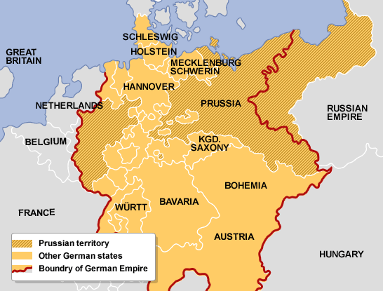
iii. ‘Peaceful Dualism’ Austrian political and Prussian economic control.
Austria and Prussia
German States 1815

Slide 6
Recap Questions
What evidence is there to suggest that German states showed no interest in reforming their constitutions after 1815? (p.13-15)
Can you find examples of how weak the German Confederation was in being an effective union? (p11-15)
Were the Carlsbad Decrees out of proportion to how strong German nationalism / liberalism was in the 1810-20s? (p18/19)
What dangers did liberals face in sharing their politics with the working classes? (p.20-21)
How did nationalist ideals change in the 1830s? What role did Metternich play in fuelling the fire? (p20-21)

