Slide 1
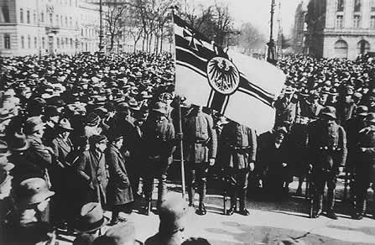
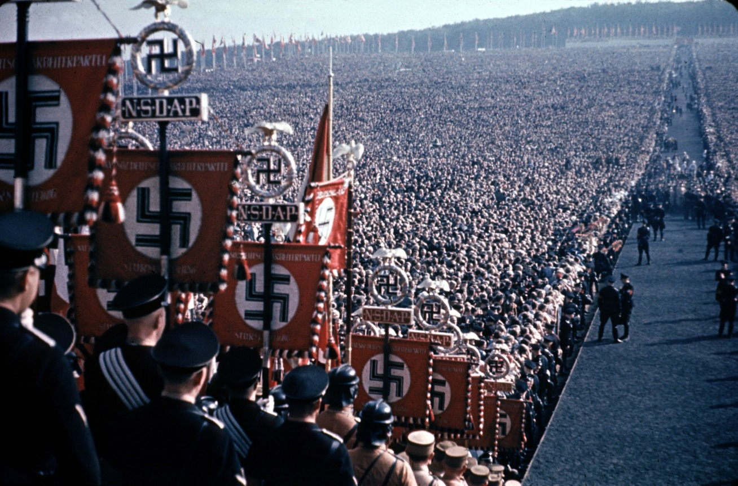
Classwork
Friday, 4 December 2020
The Origins of the Weimar Republic
Compare the two images above of Germany above.
One was taken in Weimar Germany and one in Nazi Germany.
What major differences can you see?

Slide 2
The Origins of the Weimar Republic
Classwork
Friday, 4 December 2020
Learning Objectives:
All students will understand how the legacy of WORLD WAR ONE IMPACTED UPON POST WAR GERMANY.
Most students will be able to EXAMINE THE ORIGINS OF THE WEIMAR REPUBLIC.
Some students will be able to ASSESS THE CHANCES OF SUCCESS FOR THE WEIMAR CONSTITUTION.
KEY WORDS THIS LESSON:
abdication, communist, constitution, civil servant, trade unions, electorate, coalition,
HOMEWORK:

Slide 3

The origins of the Republic, 1918-19: The legacy of WWI, abdication of the Kaiser, the armistice and revolution
HISTORICAL CONTEXT
Watch the documentary
Europe Prior to World War I: Alliances and Enemies I PRELUDE TO WW1 - Part 1/3
Notes:
Video source: https://www.youtube.com/watch?v=f11CKYB2FCA&index=1&list=PLB2vhKMBjSxMMg8xHeY2K-0ap9srI_zx7

Slide 4



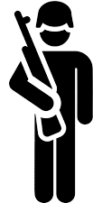



How the pre-WWI German political system worked
HISTORICAL CONTEXT
Assumed position and power through heredity
KAISER
Appointed
Summoned
Commanded
Members were chosen by state governments
Elected by all men over 25 y/o
Army
Government
Imperial Parliament
Bundesrat introduced laws to be approved by the Bundestag
Chancellor Ministers
Bundesrat
Bundestag

Slide 5


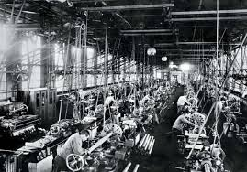







The origins of the Republic, 1918-19: The legacy of WWI, abdication of the Kaiser, the armistice and revolution
HISTORICAL CONTEXT
During the second half of the 19th century, Germany underwent industrialisation in which agricultural production was replaced by modern industries including manufacturing and construction. At the time of German unification, industrialisation was further fuelled by Germany becoming the largest industrial economy in Europe.
COAL
COTTON CLOTH
MOTOR CONSTRUCTION
IRON
German economy in 1914
The above image shows a German factory using mechanical equipment to greatly increase production. Industrialisation led to improved infrastructure and weapon production. Germany
increasingly assumed the form
of an imperial major power.
ELECTRICAL PRODUCTS
STEEL
CHEMICAL
INDUSTRY
Notes:
Image source: http://en.geschichte-abitur.de/industrialisation

Slide 6
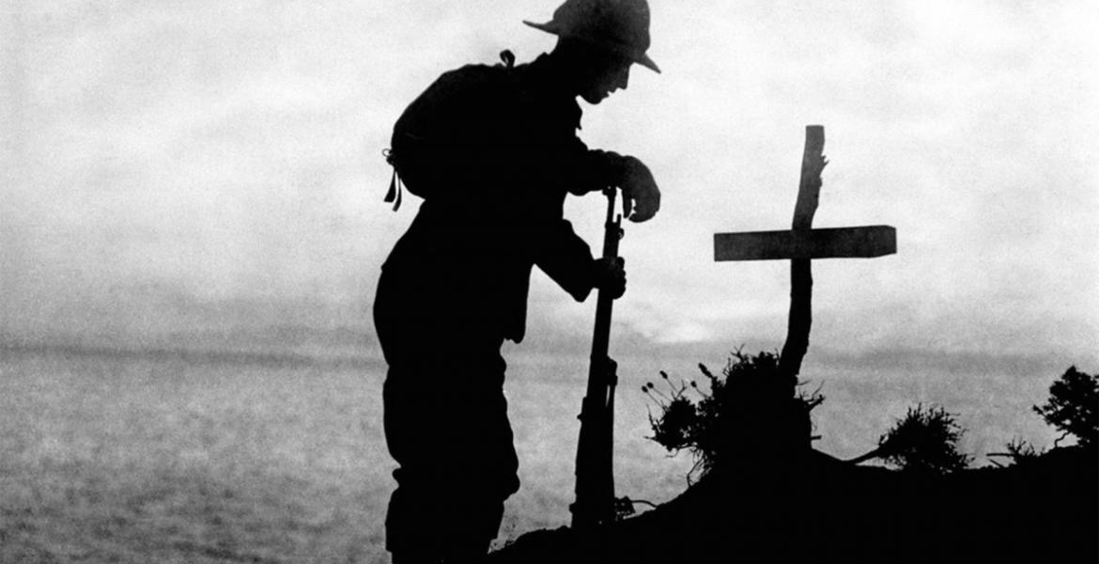
Background Context
By 1918 Europe had been at war for four years. It did not look as though Germany could win and whilst they were losing the war their economy and country was falling into chaos.
Kaiser Wilhelm II was facing worker’s strikes, soldiers mutinying, public demonstrations and revolts. Things came to a head in November 1918 and over the next nine months a German Revolution took place. The Kaiser was forced to abdicate and a new government was formed – the Weimar Republic.
The Weimar Republic faced an uphill battle from the start. The government was blamed for the loss of the war, it had to rebuild a war torn country and struggled to form a new constitution.

Slide 7
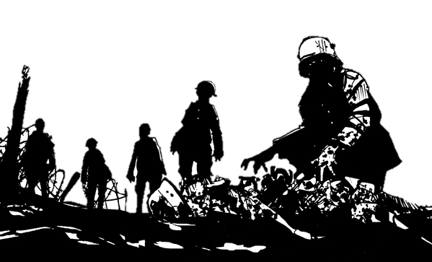
What impact did WWI have on Germany?
750,000 Germans died from starvation during WWI after the British Navy blockaded German ports.
Germany was in debt – they owed 150 billion marks.
People were now starting to look for alternative forms of government apart from the monarchy in Europe. Some Germans were talking about Communism.
55% of German soldiers were casualties.
Question:
Using this diagram explain in your own words why Germans may have been looking for a change in government by 1919.
4 million Germans had been wounded in WWI.
People lost faith in the German King, Kaiser Wilhelm II, and
2 million Germans had died in WWI.
Workers in Stuttgart, Hanover, Kiel Hamburg and Munich all rebelled and went on strike.
War had lasted from 1914-19118.

Slide 8
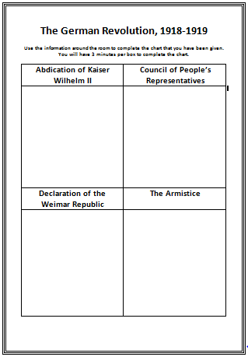

German Revolution, 1918-1919
As the war in Europe ended a revolution in Germany began. Most of the country was started to rebel against Kaiser Wilhelm II. The king was no longer in charge and most towns and cities in Germany had now set up their own councils.
          Around the room are posters giving information about the German Revolution. Using this information complete the chart that you have been given.
          You have 12 minutes to complete this task.

Slide 9
Setting up the new Republic
1. Ebert encouraged civil servants who had worked well for Wilhelm II to stay in government so that the state would keep running.
2. Ebert promised General Groener that the German army was to be kept as it was as he needed it to keep control of the country.
3. Ebert also reassured big businesses that they were safe and that the new Republic would not interfere with private industry such as coal and shipping.
4. Ebert won over the Trade Unions and promised them that he would work towards achieving an 8 hour day.
Not everybody was happy with Ebert and the new Weimar Republic. Many political parties still felt under represented and Germany was still on the edge of chaos.

Slide 10
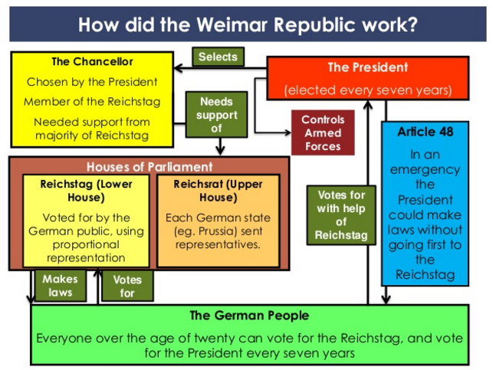
Examine the diagram on the right – copyit in to your exercise book.
Working with a partner make a list of areas of the constitution that may be strengths and weaknesses.

Slide 11
Strengths of the new Weimar Constitution | Weaknesses of the new Weimar Constitution
The Bill of Rights guaranteed every German citizen freedom of speech and religion, and equality under the law. All men and women over the age of 20 were given the vote. This was even better than Britain where only women over 30 could vote. There was an elected president and an elected Reichstag. The Reichstag made the laws and appointed the government, which had to do what the Reichstag wanted. | Proportional representation - Germans voted for a party. Each party was allocated seats in the Reichstag reflecting the number of people who voted for it. It was a disaster as it created dozens of tiny parties, with no party strong enough to get a majority, and, therefore, no government to get its laws passed in the Reichstag. This was a major weakness of the Republic. Article 48 - this said that, in an emergency, the president did not need the agreement of the Reichstag, but could issue decrees. The problem with this was that it did not say what an emergency was, and in the end, it turned out to be a back door that Hitler used to take power legally.
How close were your predictions about the strengths and weaknesses of the Weimar Constitution?

Slide 12

Homework:
You need to complete the Source/Interpretation task sheet that you have been given by your teacher.
It is due in next lesson.

Slide 13
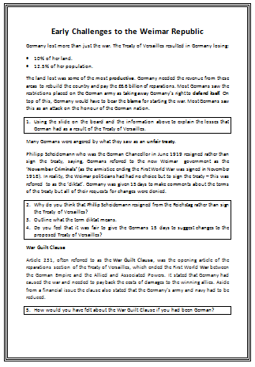
Generally Unpopular…
On 28 June 1919 the Treaty of Versailles was agreed upon and signed in Paris.
The German people welcomed peace in Europe but they were deeply unhappy with the terms of the Treaty of Versailles that was forced upon them.
This made the Weimar Republic unpopular as they had no choice but to sign then treaty and Germans felt that they had been stabbed in the back by them.
Complete the sheet that you have been given,

Slide 14

Plenary
Prediction – what will happen next? Why do you think this?

Slide 15



Classwork
Friday, 4 December 2020
Early Challenges to the Weimar Republic 1919-1923
Starter Challenge
Exlplain in your own words what you think:
The word challenge means.
3 challenges that the Weimar Republic could face.

Slide 16
Early Challenges to the Weimar Republic 1919-1923
Classwork
Friday, 4 December 2020
Learning Objectives:
All students will understand how the different early challenges to the weimar republic.
Most students will be able to identify the impact of the treaty of versailles.
Some students will be able to ASSESS THE threats from the left and right wing politicians including events in1923.
KEY WORDS THIS LESSON:
Armistice, reichstag, inflation, hyperinflation
HOMEWORK:

Slide 17
Left Wing Threats
Extreme parties from the left and right wing made up about 20% of politicians in the Reichstag. This made both Left and Right Wing Parties a threat.
Left-wing Rebellions
The Communist Party (KPD) hated the new government:
In January 1919, 50,000 Spartacists rebelled in Berlin, led by Rosa Luxemburg and Karl Leibknecht.
In 1919, Communist Workers’ Councils seized power all over Germany, and a Communist ‘People’s Government’ took power in Bavaria.
100,000 workers took to the street in support of the Spartacists.
Rioters seized control of the government controlled newspaper and telegraph offices in an attempt to control communications.
In 1920, after the failure of the Kapp Putsch, a paramilitary group called the Red Army rebelled in the Ruhr.
It looked like the Weimar Republic were losing control of Berlin.

Slide 18
Right Wing Threats
Extreme parties from the left and right wing made up about 20% of politicians in the Reichstag. This made both Left and Right Wing Parties a threat.
Right-wing Terrorism
Many right-wing groups hated the new government for signing the Versailles Treaty.
The Kapp Putsch (March 1920) was a Freikorps brigade which rebelled against the Treaty of Versailles, led by Dr Wolfgang Kapp.
It took over Berlin and tried to bring back the Kaiser.
Nationalist terrorist groups murdered 356 politicians.
In August 1921 Matthias Erzberger, the man who signed the armistice (and therefore a 'November criminal'), was shot.
In 1922, they assassinated Walter Rathenau, the SPD foreign minister, because he made a treaty with Russia.
Kapp realised he could not lead the country and ran away. The rebellion collapsed and the Weimar Government returned – the military had not helped at all.

Slide 19
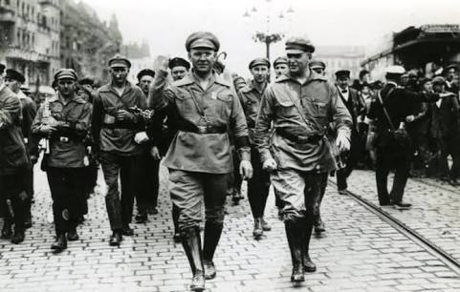
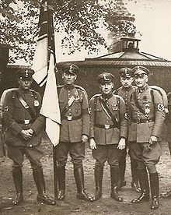

Private Armies
With so many politicians being murdered many political parties created their own private security forces:
Red Front Fighters – KPD’s private army made up from ex-soldiers.
Steel Helmets – DNVP’s private army.
Black Red Gold Flag – SPD version of a private army.
These groups were meant to be just for protection but soon became violent and made life difficult for the Weimar Government. The Republic was under attack from all areas.

Slide 20
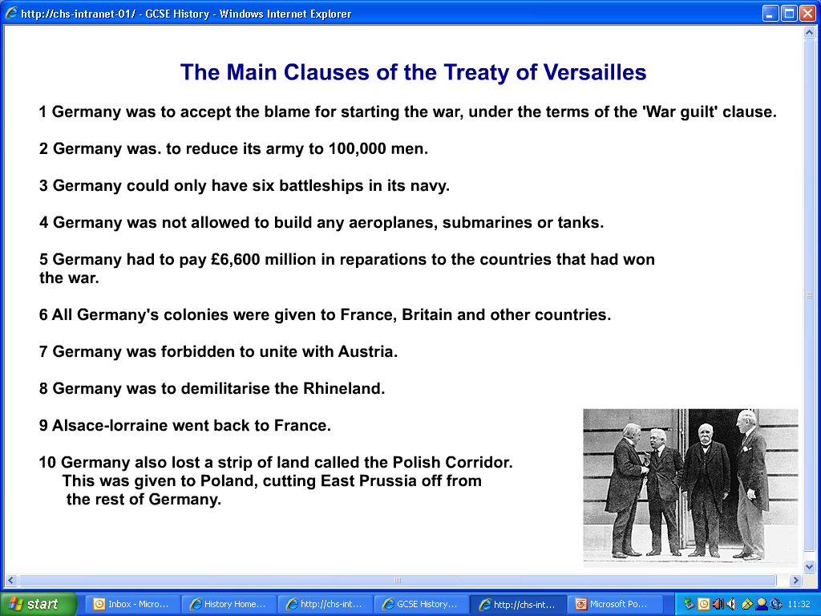
Can you spot the mistake?

Slide 21

The French Occupation of the Ruhr
Please watch the video on the right containing information about the invasion of the Ruhr and select the relevant information to make notes.

Slide 22

Hyperinflation - 1923
Please watch the video on the right containing information about the Germany’s hyperinflation in 1923 and select the relevant information to make notes.

Slide 23
Plenary
By August 1923 the new Chancellor of Germany, Gustav Stresemann, had started to discover some of the solutions to all of the problems but it was too late.
The Weimar Republic seemed weak to the general public.
The government was killing thousands of Germans to stay in power.
Hyperinflation and starvation was being blamed on the government.
It allowed extremist parties to flourish.
Plenary Questions:
What were the main political threats to the Weimar Government by 1923?
What caused hyperinflation and what were the effects of it by 1923?

Slide 24
Exam Q’s
(a) What were the roles of (i) the Chancellor and (ii) the President under the Weimar Constitution? [4]
(a) What were the disadvantages of proportional representation for Weimar Germany? [4]

Slide 25
Exam Q’s (2016s(2)
(b) Why were the 1920s a period of cultural achievement for Germany? [6]
(c) How successful had the Weimar Republic been by 1926 in resolving the problems created for Germany by the Treaty of Versailles? Explain your answer. [10]

Slide 26
Homework
Complete the following questions:
Why did some people argue that the policy of appeasement was a good idea? (6) (2017March(2))
Why, in 1939 did Stalin make a deal with Germany rather than Britain or France? (6) (2016s(1))

