Slide 1

Classwork
Monday, 30 March 2020
Recovery of the Weimar Republic 1924-29
Read the 3 sentences below. Choose which one that you think will accurately reflect the recovery of the Weimar Republic before the lesson starts:
Germany recovered enough to become a world power once again.
Germany ended up in more debt to America.
Germany paid back all of her reparations early.
Be prepared to explain why you choose your option.

Slide 2
Recovery of the Weimar Republic 1924-29
Classwork
Monday, 30 March 2020
Learning Objectives:
All students will UNDERSTAND GUSTAV STRESEMANN’S PLANS FOR THE WEIMAR REPUBLIC’S STRATEGY.
Most students will be able to EVALUATE THE DIFFERENT REASONS FOR ECONOMIC RECOVERY INCLUDING THE YOUNG AND DAWES PLANS.
Some students will be able to UNDERSTAND THE DIFFERENT REASONS FOR THE IMPROVEMENT OF FOREIGN RELATIONS WITH AN EMPHASIS ON THE LOCARNO PACT AND LEAGUE OF NATIONS.
KEY WORDS THIS LESSON:
Rentenmark, dawes plan, young plan, locarno pact, league of nations,
HOMEWORK:

Slide 3


What was Gustav Stressman’s Strategy?
In August 1923 Stresemann took over as German Chancellor but resigned by November 1923. However, he did stay on as Foreign Minister until 1929. His job was to put the country back together financially.
He had two main aims:
Restore the German economy.
Restore Germany’s position in foreign affairs.
Stresemann genuinely believed that if he could do this then people would start supporting the Weimar Republic.

Slide 4
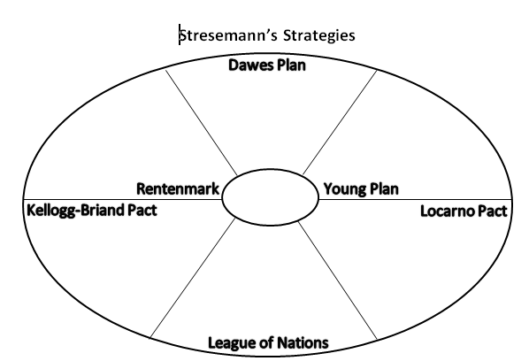
Stresemann’s Achievements
All around the room are different information sheets about various actions, Acts and legislation that were starting to help Germany’s economy and international position.
Each of you have a sheet to fill in and complete.
You can use this as a revision tool when assessing how successful Stressman and the Weimar Republic in general were in dragging Germany back to a respectable position

Slide 5
Plenary
Stresemann was having a positive impact on Germany.
Support for the Weimar Republic was increasing.
Support for the extreme Left and Right parties was decreasing.
By 1929 the Weimar Republic was now more secure and stable.
Paul von Hindenburg became President and he was much respected and was a strong figurehead.
In 1929 there was a Great Depression and Stresemann died.
The Weimar Government was under pressure.
Plenary Question:
Was the Weimar Government stronger by 1929? Why might there always have been a possible weakness regardless of how strong the economy was?

Slide 6





Classwork
Monday, 30 March 2020
Changes in German Society 1924-1929
Examine the images above and speculate as to what you think may have changed in German society under the Weimar government.

Slide 7
Changes in German Society 1924-1929
Classwork
Monday, 30 March 2020
Learning Objectives:
All students will evaluate how the standard of living changed in Weimar Germany between 1924-1929.
Most students will understand how women’s lives changed in the weimar republic.
Some students will be able to synthesise information and produce and exam answer to a question regarding cultural changes in the weimar republic.
KEY WORDS THIS LESSON:
unemployment, interpretation, architecture,
HOMEWORK:

Slide 8
How did German Society change 1924-1929?
So far in lessons we have discussed challenges to the Weimar Republic as well as economic and political issues with the government.
The next question to ask is how did the Weimar Republic change Germany between 1924-1929?
In order to do this we need to examine the following aspects of life in Germany:
Employment
Work and wages
Housing conditions
Standard of living
Changes for women
Art and culture
Read through the information sheet and complete the tasks at the end of the sheet.

Slide 9
Exam Q’s
(a) What were the roles of (i) the Chancellor and (ii) the President under the Weimar Constitution? [4]
(a) What were the disadvantages of proportional representation for Weimar Germany? [4]

Slide 10
Exam Q’s (2016s(2)
(b) Why were the 1920s a period of cultural achievement for Germany? [6]
(c) How successful had the Weimar Republic been by 1926 in resolving the problems created for Germany by the Treaty of Versailles? Explain your answer. [10]

Slide 11

Plenary
Write two “Who wants to be a Millionaire” type questions based on the content of today’s lesson with four different answer options in each case.

