Slide 1
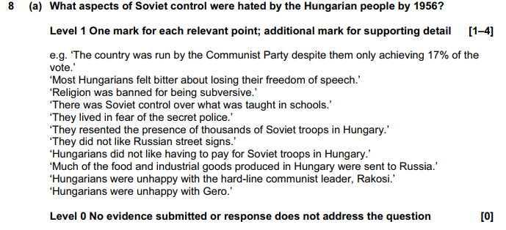
Czechoslovakia 1968
Classwork
Thursday, 12 November 2020
Learning Objectives:
All students will Be able to RECALL KEY INDIVIDUALS, EVENTS AND IDEAS FROM THE PRAGUE SPRING.
Most students will Develop and write a speech for a communist leader based on the information.
Some students will be able to EVALUATE THE similarities between hungary and Czech uprisings and their effects on soviet control of the region
KEY WORDS THIS LESSON:
Dubcek, prague spring, soviet control, resistance
HUNGARY RECAP:
a) What aspects of soviet control were hated by the Hungarian people by 1956? (4) (2016(1))

Slide 2
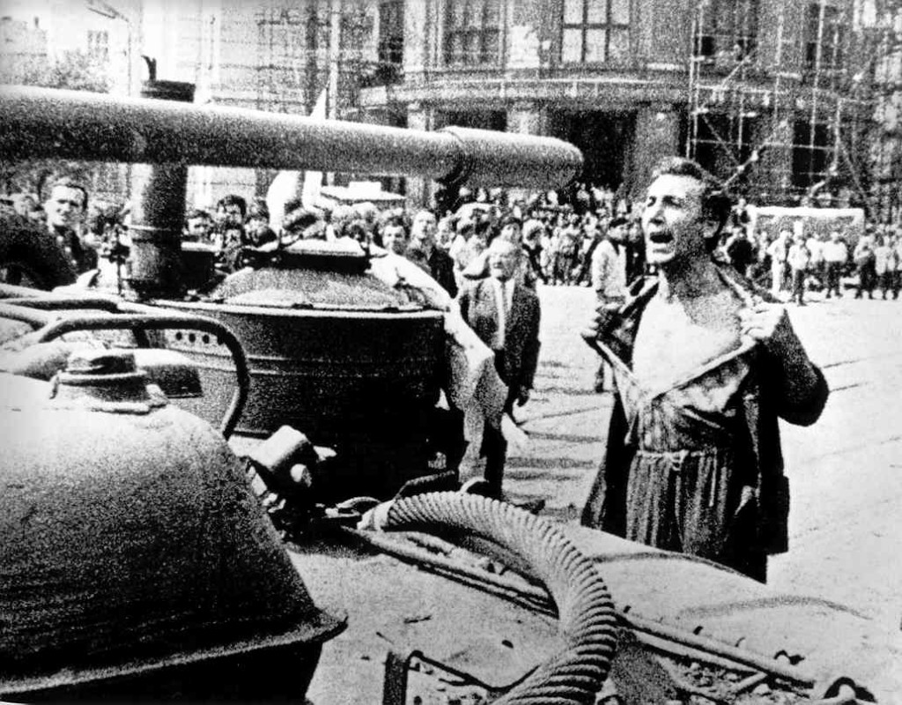
Classwork
Thursday, 12 November 2020
Title: Czechoslovakia - 1968
Write down 5 interesting things about the photograph above.

Slide 3

For four months in 1968 Czechoslovakia broke free from Soviet rule, allowing freedom of speech and removing some state controls. This period is now referred to as the Prague Spring but why did it only last four months?

Slide 4

What can you remember?
Mind-map in your books what you can remember about the ‘Prague Spring’ from the video that you just watched.
The Prague Spring
Notes:
The information sheet can be given to students to aid them with this task.

Slide 5
You Choose – Choose one of the following activities to complete based on the information sheet (& your textbook) that you have been given. They have been put into categories based upon their difficulty.
High challenge
Can be done by all
A little more stretch
How far was the Prague Spring more of a threat to Soviet Control than the Hungarian Uprising of 1956?
Use the table template on p.136 in your textbooks to help in collating information
Answer the following questions:
Why did the Czechoslovakians oppose Communist rule?
Who was Alexander Dubcek and what was his aims?
What was ‘Socialism with a human face’?
Who supported them and opposed them and why?
Write a speech that Dubcek would have given to people in Czechoslovakia.
Be passionate and enthusiastic.

Slide 6
Prague Spring: Summary of events
Using the following method break down your overall interpretation / analysis of events in the Czech capital in 1968 to one word!
Change?
Radical ?
Challenge Authority?
Break the mould?
New Way?
Crushed dreams?

Slide 7
Spring becomes winter: Brezhnev Doctrine
Classwork
Thursday, 12 November 2020
Learning Objectives:
All students will Be able to describe how the soviets responded to the events of 1968.
Most students will Develop an analysis of why the Brezhnev Doctrine showed either a weakening or strengthening of soviet control in eastern Europe.
Some students will be able to EVALUATE THE effects of Brezhnev’s actions in shaping soviet international relations with the wider world
KEY WORDS THIS LESSON:
Brezhnev; Brezhnev Doctrine; International Relations
Prague RECAP:
a) What aspects of soviet control were hated by the people of Czechoslovakia? (4) (2016(3))

Slide 8
News Reporter Task
In pairs imagine you are a news reporter working for one of the following:
  New York Times
  Pravda
Your task is write a newspaper headline or a tweet (maximum 140 Characters!) on events in Prague in 1968. Remember depending on what side you choose you will have to add some bias and agenda to your reporting!

Slide 9
You Choose – Choose one of the following activities to complete based on the information from the Brezhnev Doctrine information sheet. They have been put into categories based upon their difficulty.
Can be done by all
A little more stretch
High challenge
Answer the following questions using full sentences;
What was Brezhnev’s dilemma?
What was the Brezhnev Doctrine?
Explain what happened during the invasion of Czechoslovakia.
Answer the following questions using full sentences;
What inferences can you make from Brezhnev’s dilemma?
What is your opinion of the Brezhnev Doctrine?
How would you justify the Soviet invasion and the consequences?
Your choice!
Either;
- Create a cartoon of the Brezhnev Doctrine which would be shown in a British newspaper.
Or;
- Create an conversation with a Soviet and Czech person about what has happened.
Extension Task: Focus Task B p.132 textbooks. On a scale 1-5 mark how secure Soviet control really was for the key events in both Hungary and Czechoslovakia

Slide 10
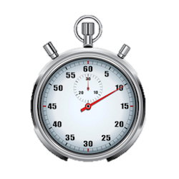
Plenary:
60 second challenge – sum up knowledge of text, or write down all the words you can think of to describe Soviet Control of Eastern Europe so far…

Slide 11
Exam Style Q’s: Prague Spring
(b) Why did the Soviet Union oppose the changes proposed by Dubcek for Czechoslovakia? [6] (2017m(2))
b) Why were the Soviets worried about events in Czechoslovakia in 1968? (6) (2014s(1))
(c) How different were events in Hungary in 1956 and Czechoslovakia in 1968? Explain your answer. [10] (2015s(1))

Slide 12
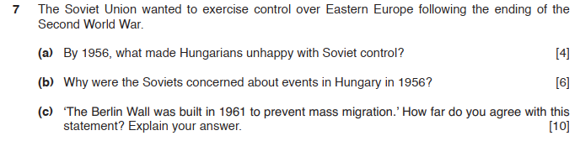
Holidays Homework!
Obviously you will be missing from lessons the week following your break due to your Geography trip!
Please complete the following Q’s. You will need to do your own research into the causes behind why the Berlin Wall was constructed. (2017(2))

