Slide 1
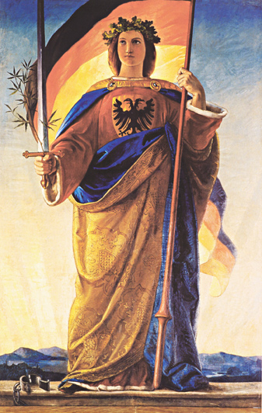
2. REVOLUTIONS IN GERMANY IN 1848-9.
WHAT WERE THE MAIN DEVELOPMENTS IN THE REVOLUTIONS?
THE FRANKFURT PARLIAMENT:
The Frankfurt Parliament was a liberal assembly of 596 men from all states given the task of drawing up a Constitution for a United Germany.
Germania, the personification of Germany. She holds the Revolutionary Flag used by the Frankfurt Parliament

Slide 2
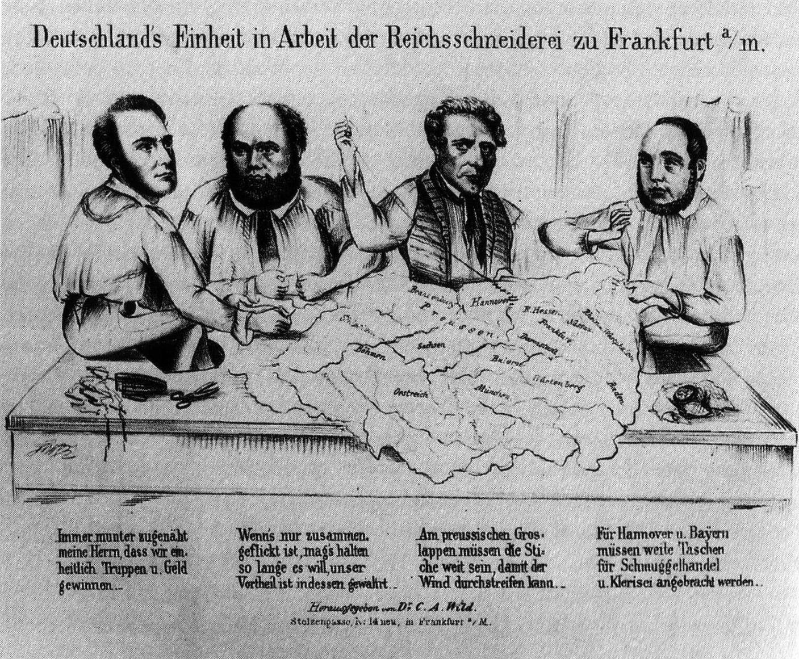
2. REVOLUTIONS IN GERMANY IN 1848-9.
WHAT WERE THE MAIN DEVELOPMENTS IN THE REVOLUTIONS?
However, it FAILED because:
it became a ‘talking shop’ without real action; there were too many different representatives who called for different things
e.g. ‘Kleindeutschland’ (a small Germany without Austria)
‘Grossdeutschland’ (a larger Germany to include Austria);
Propaganda de la Kleindeutschland, 1849.

Slide 3
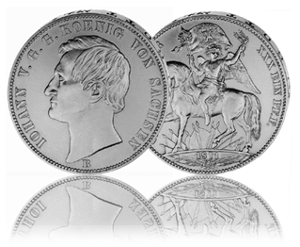
2. REVOLUTIONS IN GERMANY IN 1848-9.
WHAT WAS THE IMPACT OF THE REVOLUTION ON WHO CONTROLLED THE CONFEDERATION?
The old Confederation Diet had proposed/supported a ‘Grossdeutschland’ under the leadership of Austria.
However the 1849 constitution was to be a ‘KleineDeutschland’ without Austria
However, Prussia confirmed its economic control after Austria attempted to set up a rival Customs Union to the Zollverein called the Zollunion.
Its failure meant:
PRUSSIA KEPT ECONOMIC CONTROL VS AUSTRIA KEPT POLITICAL CONTROL.

Slide 4
Recap Questions
Describe the main economic and social problems in 1840s Germany. Do you notice any similarities with any other areas of study? (p36-38)
Was 1848 in Germany more a case of growing class consciousness or nationalism? Explain (p37-38)
What effects did Metternich’s fall have on events of 1848? (p.39-40)
To what extent did Fredrick Wilhelm of Prussia deal successfully with the revolt? (p40/41)
What were the key weaknesses which undermined the Frankfurt Parliament from its inception? (p.45-48)
To what extent was the Frankfurt Parliament a failure. Must argue both sides of argument here. (p42-52)
Copy diagram on page 52 into copybook

Slide 5
Arise, Prussia
Prussia was fast becoming the litmus test in terms of how German politics and self-identity might shape in the aftermath of 1848-49
Fredrick William – in keeping with much of successful yet idiosyncratic regime – flirted between reforming and reactionary ideals
The Prussian Constitution of December 1848 attempted to placate both radical and conservatives and find a balance between popular reforms whilst upholding traditions of the ‘Divine Right of Kings.’
Prussia’s ‘progress’ from an absolutist to somewhat constitutional form of monarchy was held up as a future blueprint for a United Germany, one more conservative / less liberal infused than the doomed Frankfurt Parliament, ultimately undermining the revolutions of 1848-49
Complete the worksheets on why the Revolutions of 1848-49 failed

