Slide 1
Stresemann’s Germany – Success of Failure?
You are now in a position where you can weigh up the evidence to say whether or not Weimar Germany until 1929 was a success or not (on the one hand …. The other..)
Complete the following mind-map (think task p.251) and develop your own summary on what the Weimar Republic did well and where it remained weak.
Politics
The economy
How far has the Weimar Republic recovered?
Foreign Policy
Culture

Slide 2
End of Unit KU Test
You can increase your chances of success in the test by revising the following:
The forces and ideologies at play during the “German Revolution” 1918-20 – different factions and attempts to overthrow government (Kapp Putsch)
ToV and how it shaped German post-war attitudes
Occupations and Reparations – what were they and how did they affect Germany?
Key features - good and bad - of the Weimar Constitution
Streseman’s recovery plan – what solutions did he put in place / treaties / currency etc?
Cultural and Social trends of Weimar Golden Age – art, film and nightlife
What were the fatal weaknesses which ultimately proved too much for Weimar Germany?
Overall – how does History see the Weimar Republic’s achievements? (on the one hand .. On the other hand…)
Test will take 40mins approximately
You will be tested on your knowledge of the unit.
The test consists of the following:
  12 Multiple Choice Q’s
  4 mark Q
  6 Mark Q
  10 mark Q

Slide 3
What changed?
Both pictures below are of the same organization, a decade apart. In pairs discuss the key aspects of change.
What do you think had to be changed in terms of attitude, organisation, ideology to go from this ………………………………………………………………….to this??

Slide 4
Early Development of the Nazi Party 1920-1922
Classwork
Tuesday, 12 January 2021
Learning Objectives:
All students will examine hitler’s early career in politics, including his own personal charisma and appeal.
Most students will understand the policies of the nsdap.
Some students will synthesise information to answer an exam question.
KEY WORDS THIS LESSON:
Propaganda, nationalism, socialism, paramilitary force,
homework task (2016(2)):
Why were the 1920s a period of cultural achievement for Germany? [6]

Slide 5


Adolf Hitler is one of the most infamous men ever to have lived.
He is known mainly for his association with WWII and his hatred of the Jews. But his time as leader of Germany only covers the last 12 years of his life!
What about his early life? What was he like as a young man? How and why did he get involved in politics? And why was the Austrian (yes, he wasn’t German at all) chosen to be Germany’s leader in 1933?
From the following slides summarize the following:
His childhood
His academic performance
His ‘lost’ years in Vienna
His ability as a soldier
Do you think he would be a good politician? Why?

Slide 6
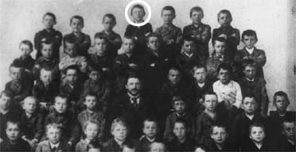
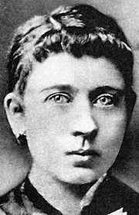
  A Choirboy?
Hitler was born in 1889 in Branau in Austria. His dad was a bully, an alcoholic and worked in the Austrian Civil Service. He often hit Hitler and died when he was 14 years old.
Hitler’s mum, Klara, spoiled him and insisted that he went to a grammar school in order to get a good education and a well paid job. But Hitler went from a straight A student at elementary school to one failing badly by the time he was 16.
“He always wanted his own way. He was boastful, bad-tempered
And lazy… He ignored advice and got angry if he was told off.”
A quote from Hitler’s Teacher
For the next 2 years he lived at home reading books, listening to music and painting. His mum died of cancer when he was 17 and Hitler left Braunau to travel to Vienna to look for work.

Slide 7
Hitler in School
“Hitler was certainly gifted, although only for particular subjects. He lacked self-control and, to say the least, he was considered argumentative, autocratic, self-opinionated and bad-tempered, and unable to submit to school discipline. Nor was he industrious; otherwise he would have achieved much better results, gifted as he was. He reacted with ill-concealed hostility whenever a teacher reproved him or gave him some advice. At the same time, he demanded the unqualified subservience of his fellow-pupils, fancying himself in the role of a leader, and of course playing many small harmless pranks, which is not unusual among immature youngsters.”
In your copybook, re-write the statement above IN YOUR OWN WORDS.
What do you think these comments say about Hitler’s character?

Slide 8
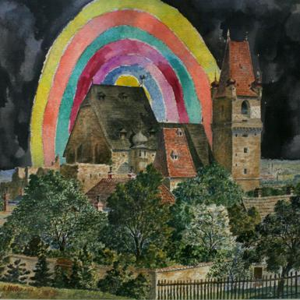
  Artist and a Tramp
In 1907, Hitler arrived in Vienna hoping to ‘make it big’ as an artist. He tried to get into Vienna Art Academy, one of Europe’s best art colleges, but failed to pass the entrance exam. Without any qualifications, he ended up living in a hostel for tramps.
“On the very first day there sat next to the bed that had
been given to me a man who had nothing on except an
old torn pair of trousers – Hitler. His clothes were being
cleaned of lice, since for days he had been wandering
aboutwithout a roof over his head.”
?
For the next 5 years, Hitler earned money any way he could – cleaning windows, painting houses, drawing and selling postcards in the streets. He grew to hate people of foreign races, particularly rich Jewish people. He felt that foreigners were ruining Austria by taking over all the jobs and introducing their way of life.

Slide 9
Hitler applied to art school after school.
Time after time he faced rejection, and soon his inheritance was all gone.
He became penniless and slept rough. He had 5 years of ‘hardship and misery’.
On the following slide you will see one of Hitler’s paintings.
Task:
What do you think about it?
Do you think it is good?

Slide 10
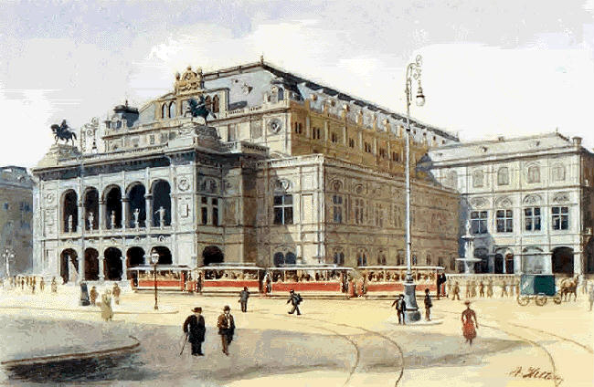

Slide 11
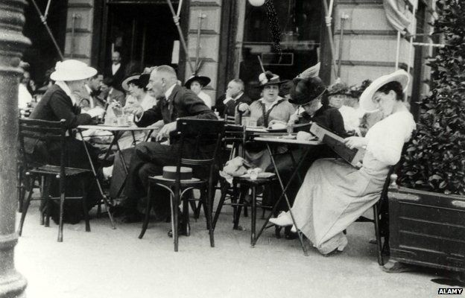
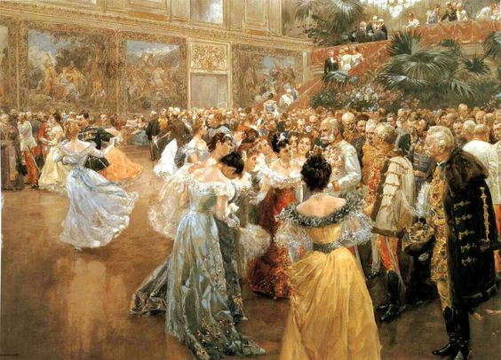
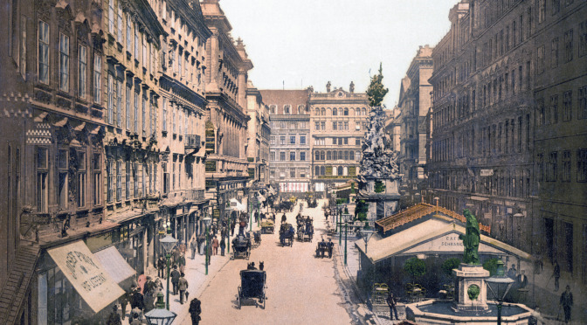
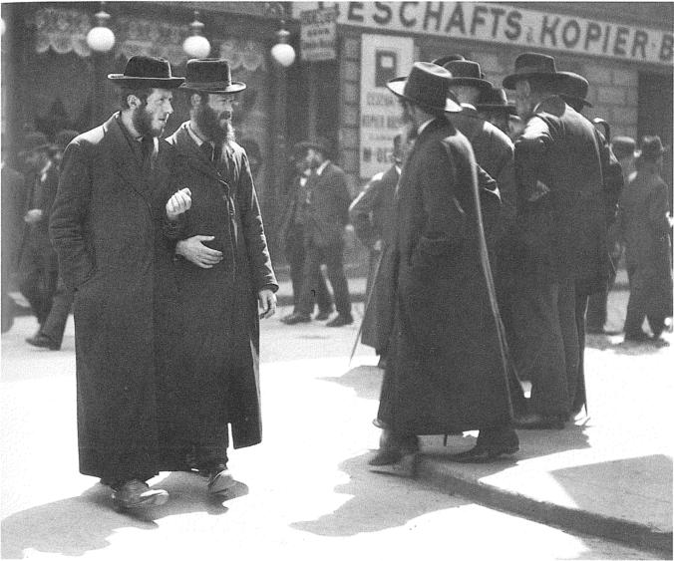
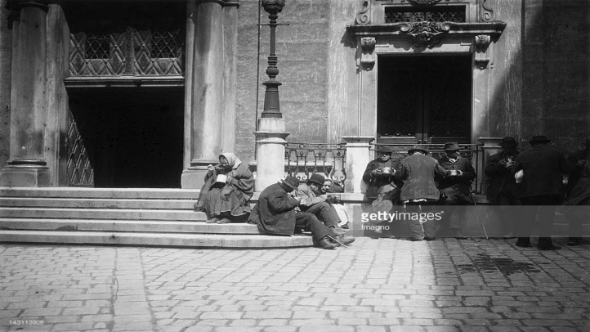
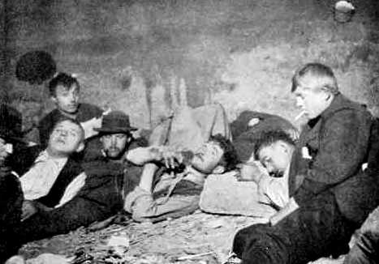
Hitler in Vienna
Hitler moved to Vienna in pursuit of his Artistic dreams
Vienna was the capital of a huge multi-national empire at the time. Arts and culture flourished.
Soon he was penniless and homeless. He refused to accept failure in his artistic career however.
Hitler lost the few friends he had and sunk into depression. He experienced his first hatred towards Jews at this time.
Hitler found life difficult in Vienna and soon his small inheritance was gone. He had to make ends meet doing menial jobs.

Slide 12
WHICH FACTOR IS MOST IMPORTANT?
Abusive Relationship with his father
Rejection from Art school three times
Lack of friends and socialising at school
His mother dying of breast cancer when he was 18
Discuss in pairs and put IN ORDER of the MOST IMPORTANT INFLUENCE

Slide 13
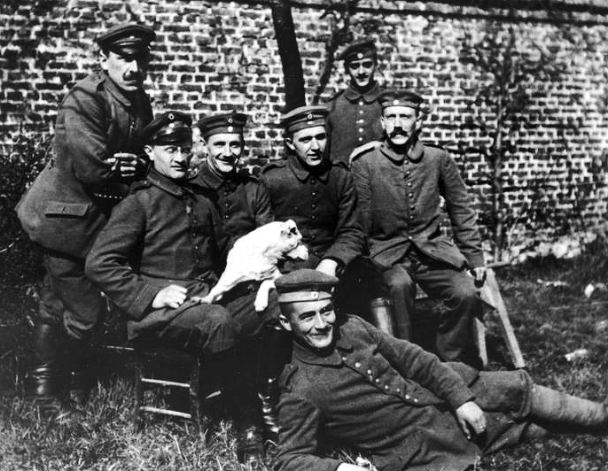
  Soldier
Hitler left Austria in 1913 to avoid being called into the army. He went to live in Munich, Germany. When the Great War started in 1914, he decided to be a soldier after all, and joined the German army.
Hitler worked all through the war as a messenger in the trenches. It was a dangerous job and he was wounded seven times. He nearly died. He won medals for bravery.
Hitler was in hospital when WWI ended, having been temporarily blinded in a gas attack. He wrote that he buried his head in his pillow and cried when he heard the news. He blamed Germany’s surrender on weak politicians… and, of course, the Jews.

Slide 14
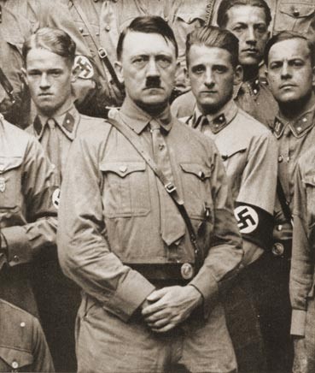

  Politician
Hitler stayed in the army after the war as a spy. One political group that he spied on weren’t dangerous – they had few members & funds of only 7.5 marks – about £4. They were called the German Worker’s Party.
Hitler liked their ideas & became a member of the German Worker’s Party. He made speeches, wrote letters & expressed his ideas. Hitler spoke passionately about Germany’s need for a strong leader who would get revenge for Germany losing the war. By 1921 Hitler was in charge of the group & changed their name to the Nazi Party.
Soon Hitler made the swastika the symbol of the Nazis and used brown shirted ‘storm troopers’ to beat up people who disagreed with him when he made speeches.

Slide 15
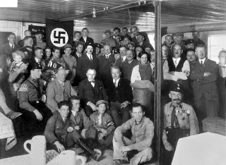
The National Socialist Program
Hitler was a quick mover in the world of politics after joining the small German Worker’s Party. Noted for his passionate and fiery speeches, quickly he found himself promoted to Chief Political Officer of the party and in charge of its propaganda
With Hitler increasingly becoming the party in 1920 the party renamed itself the National Socialist German Workers Party (Nazi) and announced its 25 Point Programme which formed the foundation of Nazi ideology and ambition.
You have each been provided with a copy. Carefully read through each point.
Why might these aims have appealed to the German population of 1920? Are there any aims which would have upset people? Choose 5 each!
For each aim categorise it under the following headings:
  Political
  Economic
  Foreign Policy
  Social / Cultural

Slide 16
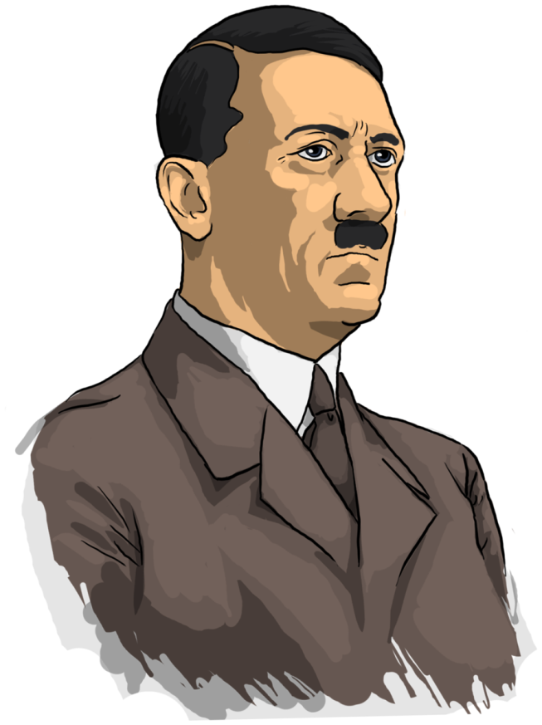
Hitler’s Personal Appeal
He made sure that photographs were taken of him at his speeches so that people could see how powerful and strong he was as a potential leader.
Hitler was a driven person and used this drive to reorganise the NSDAP into a force to be reckoned with.
Hitler was not the only member of the NSDAP but it was clear to everybody that he was the main reason why people were joining the political party.
Hitler ensured that he practiced his arm gestures, his glances and hand movements.
Hitler was a great speaker since he rehearsed his speeches and knew had to build up the tension as he spoke. He was passionate and persuasive.
As Hitler’s popularity grew so did the membership of the NSDAP. It went from 1000 to 3000 people in one year.
Hitler joined the NSDAP in 1919 and by 1921 he was their leader. Support for the nationalist party depended upon popular support.
Getting his message across to people was vital – he was the star speaker on 31 different occasions between 1919-1920.

Slide 17
How did Hitler develop the Nazi Party?
In order to became a strong contender for power Hitler needed to reorganise the NSDAP.
Jan 1920 – new political headquarters set up in Munich, meetings better organised and Party membership and funding rose.
Hitler changed the name to National Socialist German Worker’s Party (Nazi Party).
Hitler changed the party image – swastika, uniform, one armed military salute – it now stood out in Germany.
Dec 1920 – the Nazis now had enough funding to spread their political ideas in a newspaper – People’s Observer. It cost 180,000 marks and had 11,000 copies which later rose to 17,000.
By July 1921 Hitler was now the leader supported by Rudolf Hess, Hermann Goering, Julius Streicher and Ernst Rohm.

Slide 18
Classwork
Tuesday, 12 January 2021
Munich Putsch and Lean Years – 1923-1929
“Instead of an armed coup, we shall have to hold our noses and enter the Reichstag. If outvoting them takes longer than outshooting them, at least the result will be guaranteed… sooner or later we shall have a majority and, after that- Germany!”
Adolf Hitler - Feb 26 1925
Question:
What do you think that the Nazi Party did in Germany from reading this statement above from Adolf Hitler?

Slide 19
Munich Putsch and Lean Years – 1923-1929
Classwork
Tuesday, 12 January 2021
Learning Objectives:
All students will develop an understanding of the causes of the increase in popularity of the Nazi party.
Most students will understand the consequences of the munich putsch in 1923.
Some students will learn about the lean years of the nazi party and the reason for limited support at that time.
KEY WORDS THIS LESSON:
putsch, totalitarianism, interpretation
Starter task (2016(2)):
Why were the 1920s a period of cultural achievement for Germany? [6]

Slide 20
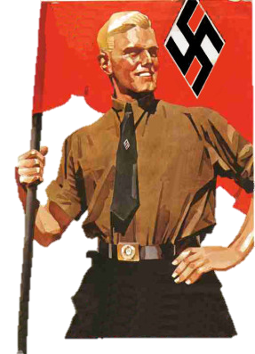
The SA - 1921
Hitler set up a group within the Nazi Party which would protect his political meetings from rival attacks. They had a military look as well as giving discipline to the party. This group was known as the ‘stormtroopers’ (Sturm Abteilung – SA) or ‘Brownshirts’.
Most members of the SA were ex soldiers unemployed since the end of WWI. As the SA grew, they went from simply protecting Hitler and Nazi meetings from opponents and started disrupting the meetings of rival political groups.
As the Nazis gained power democratically, the SA gained a reputation as an organised gang of thugs. This frightened and put many off joining the Nazi Party, but others were actually attracted by the organisation and discipline of a uniformed group.
They helped Hitler keep power when he took control of the Nazi Party completely in 1922.

Slide 21
Taking Advantage…Munich Putsch
In 1923 the Nazi Party decided to take advantage of the Ruhr Crisis to launch an attack on the leadership of the country.
Hitler plotted with two other politicians to take over Munich in a revolution.
Hitler gathered his SA and told them to be ready to rebel.
4 October 1923 – the supporting politicians called off the rebellion which was frustrating for Hitler who had 3000 SA ready to rebel.
8 November 1923 - Hitler and 600 SA burst into a meeting at a local Beer Hall. Using a gun Hitler forced them to rebel and then let them go home. The SA took over the army headquarters and the offices of the local newspaper but most of the army remained loyal to the government.
9 November 1923 - Hitler and his Nazis went to Munich on what they thought would be a glorious march for power but surprisingly the townspeople and three key Bavarian politicians failed to support Hitler and with 2000 rifles he was outgunned.
There was a short scuffle in which the police killed 14 Nazis and 4 policemen were shot dead.
Hitler was knocked to the ground, dislocated his shoulder and then fled but was arrested two days later on 11 November.

Slide 22

Exam Style Question:
Explain why the Munich Putsch did not succeed in 1923.
You may include the following in your answer:
The failure of the German army to support Hitler.
The lack of support from the Munich townspeople.
Remember to apply your PEEL structure. Feel free to include any other factors you think also explain the Putsch’s failure
In order to achieve a good grade try to fully explain at least two factors which can be said to have caused the failure of the Munich Putsch in 1923.

Slide 23
Mark Scheme
Why did the Munich Putsch fail?
Level 4 Explains TWO reasons [6]Level 3 Explains ONE reason [4–5](One mark for an explanation, additional mark for full explanation.)
e.g. ‘The Munich Putsch failed because Hitler overestimated the level of support he wouldhave. He thought that General Ludendorff would be able to persuade the army to support theputsch, and that leading members of the Bavarian state government would do the same.Hitler was wrong. The army remained loyal to the Weimar government and the Bavarian head of government called out the armed police to break up Hitler’s march through the streets of Munich.’ (5 marks)
Level 2 Identifies AND/OR describes reasons [2–3]
(One mark for each identification/description)
e.g. ‘The army remained loyal to the Weimar government.’
‘Hitler had miscalculated the mood of the German people.’
‘The German people did not rise up to support the putsch.’
‘Kahr, the head of the Bavarian government, went back on his word to support Hitler.’‘Hitler’s Nazi Party was still small.’
Level 1 General answer lacking specific contextual knowledge [1]
e.g. ‘It failed because it was not well organised.’

Slide 24
Munich Putsch Consequences
What were the consequences of the Munich Putsch?
Hitler was found guilty of treason and sentenced to 3 years in Landsberg Prison.
Hitler used his trial to gain national publicity.
Hitler strategised and wrote Mein Kampf which inspired his manifesto.
NSDAP was banned but they still managed to win 32 seats.
Hitler realised that he needed a new strategy.
Copy the diagram on the left and then answer the questions below:
In what ways can the Munich Putsch be considered a success for Adolf Hitler and the Nazi Party?
Do you feel that the Munich Putsch was more of a success or failure for the Nazi Party?

Slide 25
The Growth of the Nazi Party
Classwork
Tuesday, 12 January 2021
Learning Objectives:
All students will develop an understanding of the causes of the increase in popularity of the Nazi party.
Most students will understand the consequences of the munich putsch in 1923.
Some students will learn about the lean years of the nazi party and the reason for limited support at that time.
KEY WORDS THIS LESSON:
putsch, totalitarianism, interpretation
Starter: Describe Hitler’s role in establishing the nazi party prior to 1923? (4)
(remember – 4 basic points or 2 developed ones)

Slide 26
Mark Scheme
Describe Hitler’s role in establishing the Nazi Party prior to 1923.
e.g. ‘Hitler took on responsibility for publicity and propaganda.’
‘Hitler was responsible for organising public meetings.’
‘Hitler suggested the party should change its name to the National Socialist GermanWorkers’ Party (NSDAP).’
‘Hitler became the leader of the Nazi Party in 1921.’
‘Hitler’s speeches attracted attention.’
‘In 1921 Hitler founded the SA.’

Slide 27
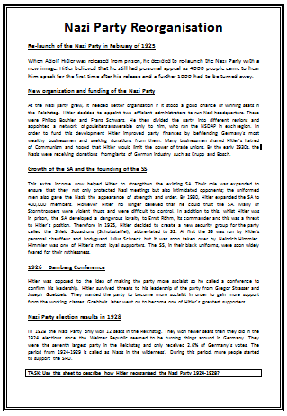
Nazi Party Reorganisation
If Adolf Hitler and the Nazi Party were serious about winning seats in the Reichstag they needed to change the way the German people saw them.
Hitler set about revolutionising all aspects of the party.
Read through the sheet that you have been given on ‘Reorganising the Nazi Party’ and then complete the task.

Slide 28
Classwork
Tuesday, 12 January 2021
The Growth of the Nazi Party
Follow the Leader
One of you will be given a statement or sentence which you will say out loud.
Another pupil has to come up with a statement or sentence related to the same topic which begins with the last letter of the previous sentence.
We will see how far we can develop the information.
Notes:
Adolf Hitler was in charge of the Nazi Party from 1922.

Slide 29
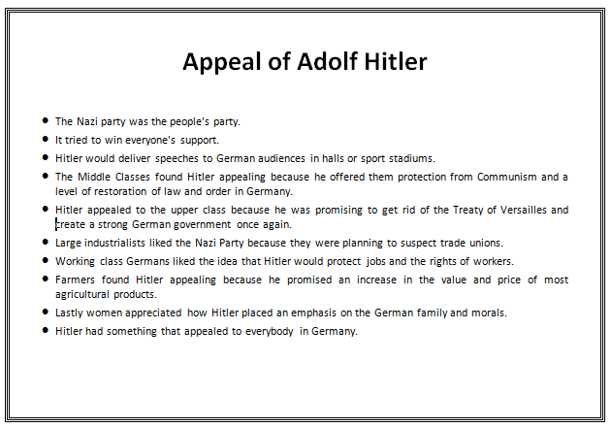
Out of the Dark…
When things are going well in a country nobody looks to change government but when things start to go badly an alternative is sought.
1929 marked the turning point for both the Nazi Party and the Weimar Republic.
From 1929-1932 the Nazi Party saw its popularity increase.
During the same years the Weimar Republic started to weaken.
Around the room are a series of information sheets. You need to take the table that you have been given and sort the information in to the right columns.

Slide 30
Exam Style Questions (2016s1):
Please answer the following questions for homework – due Monday!
What were the disadvantages of proportional representation for Weimar Germany? (4)
Why were the Spartacists a threat to the German Republic? (6)
To what extent were Weimar governments successful between 1923 and 1929? Explain your answer. (10)
Remember! For b) and c) answers use your PEEL structure when responding.
For part c) remember to show BOTH sides of argument – have two paragraphs for the side you agree with and one for the side of argument you feel is weakest

Slide 31
Year 10 Homework – March Holidays
Please answer the following questions using your exam answering technique. You are allowed to use your copybooks and textbooks!
After 1923, Germany showed signs of recovering from its earlier problems.
(a) In what ways was the Nazi party affected by the Munich putsch? [4] (2017(2)
(b) Why did the popularity of the Nazi Party increase between 1929-33? [6] (2016(3))
(c) ‘The weaknesses of the Weimar Constitution were the main reason for the collapse of the Weimar Republic.’ How far do you agree with this statement? Explain your answer. [10] (2016w(2))
Remember! For b) and c) answers use your PEEL structure when responding.
For part c) remember to show BOTH sides of argument – have two paragraphs for the side you agree with and one for the side of argument you feel is weakest

Slide 32

Plenary
Summarise the topic of Nazi’s in 1920s in 5 sentences.
Then reduce to 5 words.
Now reduce to one word.

