Slide 1
Wars of German Unification
Part 1

Slide 2
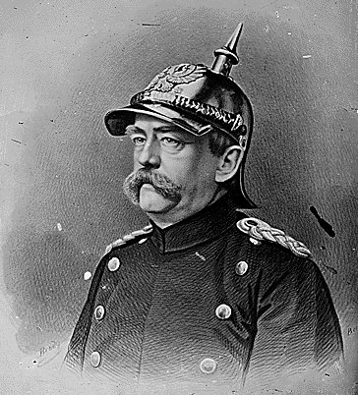
4. DIPLOMACY AND WAR, 1862-71.
BISMARCK
Bismarck was appointed Minister President in 1862. He quickly solves the Constitutional crisis by overriding Parliament.
What were his aims in 1862? (p79-80)
What parallels can you draw with Cavour’s position in 1859?
Complete the diagram on p.80

Slide 3
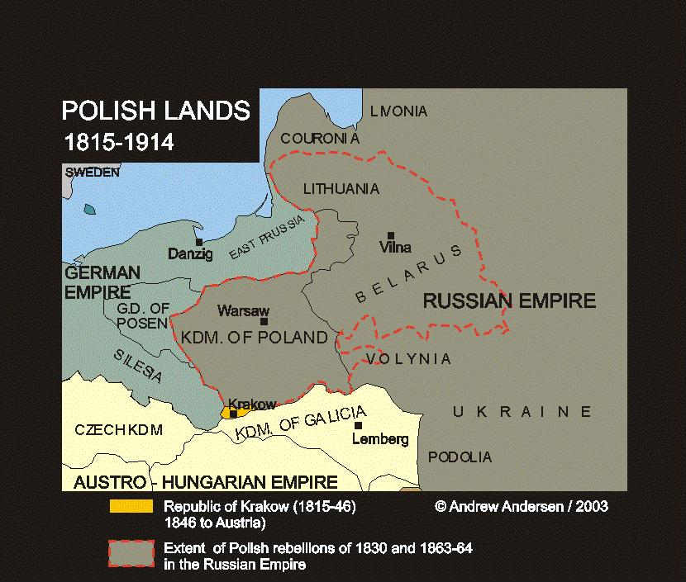
4. DIPLOMACY AND WAR, 1862-71.
THE POLISH REVOLT 1863.
CAUSES:
Poland had been divided between Russia, Austria and Poland in the 18th Century.
Poles in Russia revolted in 1863 because they wanted independence from the absolutist rule of the Tsar.

Slide 4
4. DIPLOMACY AND WAR, 1862-71.
THE POLISH REVOLT 1863.
EVENTS:
Bismarck offered assistance against the Russian Poles but was refused. At the ‘Alvensleben Convention’ Bismarck agrees to send any Polish rebels back to Russia.
Austria and France condemn this action and Prussian Liberals call for his dismissal. As a result Bismarck is forced to deny the agreement existed.
CONSEQUENCES:
Russia was angered by Bismarck’s denials.
However, she was more angry at Austria after the Crimean War.
Therefore Russia was likely to remain neutral if a war broke out between Austria and Prussia.

Slide 5
4. DIPLOMACY AND WAR, 1862-71.
WAR WITH DENMARK 1864.
CAUSES:
King Frederick VII of Denmark who ruled North German states of Schleswig and Holstein died leaving no heir. It led to a succession dispute between the German Prince and the Danish.
EVENTS:
Prussia supported the German Prince and Austria, decided to join with Prussia to invade Schleswig and Holstein.
Prussia and Austria defeated the Danes quickly. At the Treaty of Vienna in October 1864 Prussia and Austria agreed to jointly control both territories

Slide 6
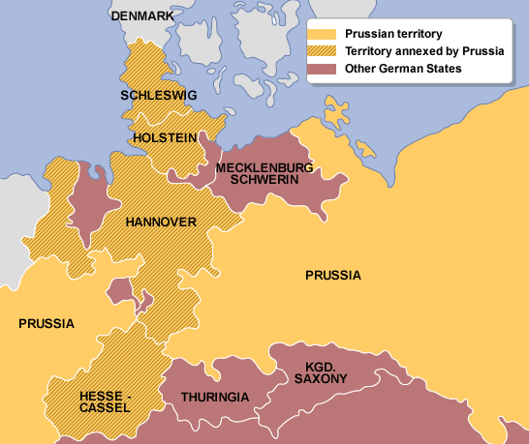
4. DIPLOMACY AND WAR, 1862-71.
WAR WITH DENMARK 1864.
The Convention of Bad-Gastein decided that Prussia would govern Schleswig and Austria would govern Holstein.
CONSEQUENCES:
This situation now meant that relations between Prussia and Austria began to deteriorate rapidly.
It ultimately led to the outbreak of the Seven Weeks War between them.
Schleswig-Holstein 1864 - 65 and the Seven Weeks War
German states annexed by Prussia 1866

Slide 7
4. DIPLOMACY AND WAR, 1862-71.
THE SEVEN WEEKS WAR BETWEEN
AUSTRIA AND PRUSSIA JUNE-JULY 1866.
CAUSES:
Tensions between the two states grew over Schleswig and Holstein.
Prussia made a secret alliance with Italy in April 1866 whereby Prussia promised to declare war on Austria within 3 months and hand Venetia over to Italy in the event of victory.

Slide 8
Recap Questions
Were Bismarck’s actions during the Polish revolt a success? (p.81)
Why did Bismarck – and German nationalists generally – see the Schleswig-Holstein problem as an ideal opportunity? (p81-82)
How did the war with Demark helped to create the growing hatred between Austria and Prussia? (p.83-84)
What did Bismarck to do escalate the situation and make conflict unavoidable between Austria and the Prussians? (p.83-84)

Slide 9
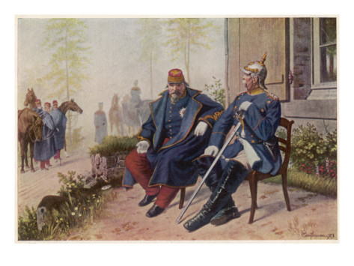
4. DIPLOMACY AND WAR, 1862-71.
THE SEVEN WEEKS WAR BETWEEN
AUSTRIA AND PRUSSIA JUNE-JULY 1866.
EVENTS:
Bismarck meets Napoleon III at Biarritz in October 1865 to try to gain French neutrality in the event of an Austro-Prussian War.
Napoleon agrees to gain Venetia which she would then hand to Italy.
Bismarck puts forward plans to reform the German Constitution which would give Prussia increasing control. The Austrians obviously oppose it and in anticipation of further trouble, in defence, they mobilise their armies in April 1866. Prussia is now given the excuse they needed and invades Holstein.

Slide 10
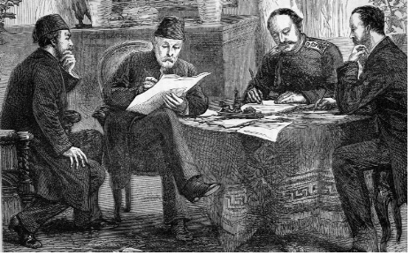
4. DIPLOMACY AND WAR, 1862-71.
THE SEVEN WEEKS WAR BETWEEN
AUSTRIA AND PRUSSIA JUNE-JULY 1866.
EVENTS:
With the help of the Italians Prussia decisively defeat the Austrians on 3rd July 1866.
William I, von Roon and other leading Generals like von Moltke wanted to march onto Vienna and bring Austria under Prussian control.
Bismarck advised against this and advises that Prussia should end the War. (He was worried that France and Russia might get involved to stop them).
Bismarck organises for the Prussians and the Austrians to meet at Prague in August 1866.

Slide 11
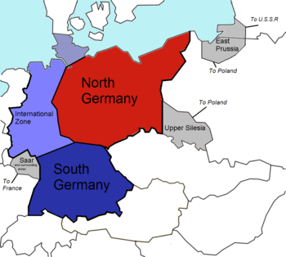
4. DIPLOMACY AND WAR, 1862-71.
THE SEVEN WEEKS WAR BETWEEN
AUSTRIA AND PRUSSIA JUNE-JULY 1866.
CONSEQUENCES:
The Treaty of Prague in August 1866 was incredibly lenient on Austria.
The North German Confederation is set up and Germany is now divided into:
  The North German Confederation (led by Prussia) and
  Austria and 4 independent South German States which formed themselves into a union (Bavaria, Wurrtenberg, Baden and Hesse-Darmctadt) also Austria lost Venetia to the Italians (through France)

Slide 12
Recap Questions
Do you think Prussia was pre-destined to win against Austria? Explain, giving reasons on the relative state of each country and outside help. (p.84-86)
What were the key factors behind Prussian success in the Seven Weeks’ War? (p.86-87)
Were Bismarck’s actions in 1866 those of a man wishing for complete German Unification or of someone wishing to extend Prussian dominance over Northern Germany? (p.88-90)
Was the constitution of the North German Confederation (1867) and new Reichstag likely to appeal to German Liberals? (p.90-94)
In your own words, briefly summarise the key factors which helped Bismarck in seemingly securing an inevitable German Unification under Prussian dominance. Copy diagram on p.98 once complete (p.95-98)

