Slide 1
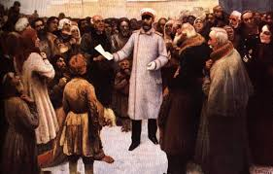
What state was Russia in in 1894?
In the next few lessons, you will...
Consolidate your understanding of the structure of Russian society in 1894.
Consider how stable and balanced Russian society was 1894
Analyse the threats posed to Nicholas II from a social, economic and political perspective in the 1890s.
Lesson 1

Slide 2
It’s important that you understand the structure of Russian society at the beginning of Nicholas II’s rule, so that you can evaluate how much stable Russian society was by the turn of the 20th century. How likely was a Revolution to happen and why?
Complete your sheet, adding notes about each section of society included on the ‘Russian Wedding Cake’. Note-taking is a key skill... Make sure you add:
Key statistics and facts.
Interpretations by historians.
Important contextual information.

Slide 3
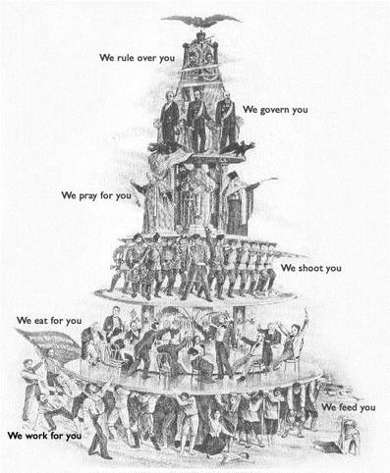
The hierarchy of Russian society under Nicholas II
“We rule over you”: The Tsar...
“We govern you”: The Tsar’s government...
“We pray for you”: The Orthodox Church...
“We shoot you”: Police...
“We eat for you”: The nobility and (just below) the intelligentsia...
“We work for you”: The People...

Slide 4
State of Russia 1894: Geography

Slide 5
State of Russia 1894: The Tsar
Russia was an absolutist monarchy upon which the Tsar sat at the top.
He governed his peoples with impunity and was answerable to no one but God.
Since 1613 the Tsars had been members of the Romanov Dynasty
The Fundamental Laws of the Empire defined Tsarist rule as ‘unlimited’ and that ‘God himself ordains that all must bow to his supreme power.’
Nicholas II assumed the role as Tsar in 1894. In a time of great social, economic and cultural change across Russia and the wider European world it was ironic that he was the most limited, reactionary and uninspiring Tsar for some time, lacking in statesmanship and presence
His predecessor – Alexander III – had been a repressive and tough Tsar who was deeply suspicious of any reform which limited his autocracy and Nicholas continued in his fathers footsteps
Nicholas and Alexander III were heavily influenced by the arch-conservative reactionary Konstantin Pobedonotsev, who loathed the developing parliamentary democracies springing up across Europe.

Slide 6
State of Russia 1894: The Orthodox Church
One of – if not the most significant - the great pillars of the Tsarist system, the Orthodox Church was a huge proponent of autocratic Tsardom and also was massively resistant to any progressive change
Had developed independently of mainstream Western European Christianity, and was seen as an intrinsic part of Russian culture and identity.
Despite the unique beauty and allure of its choral singing and architecture, by 1894 many of Russia’s growing urban working class had grown increasingly detached from the Church, and it was losing relevance in the cities.
In the countryside the church along with the Tsar was the central backbone to people’s lives
‘God commands us to love and obey from the innermost recesses of our heart every authority, and particularly the Tsar.’

Slide 7
State of Russia 1894: Politics and Organs of State
Of all the Great Powers, Russia was the true outlier by the dawn of the 20th century in political reform. Whilst everywhere else was enacting liberal-oriented reforms and opening up parliamentary or constitutional rule, the Russia of 1894 maintained almost feudal values of autocracy.
The three official organs of government were as follows:
  The Imperial Council – aristocratic associates of the Tsar who acted as his closest advisors
  The Cabinet of Ministers – they oversaw the operations of the various government departments
  The Senate – they oversaw the legal operations and passing of laws.
Ultimately all of the above were merely window-dressing; they were all merely advisory and had no recourse to argue against the rule and authority of the Tsar, who had handpicked those involved anyway!
The government was propped up by a huge, self-serving and corrupt bureaucracy which was more an enemy of its people than acting out its intended role of serving them.
Ultimately, change could only be enacted from the top. Something which was not likely to happen!

Slide 8
State of Russia 1894: Social Structure - Nobility
The social structure of Russia in the 1890s finds parallels to that of France of the 1780s. A large and politically and economically disconnected peasantry, a small but increasingly politically aware urban mercantile and working class and a self-serving, bloated ruling class who lorded it over the rest.
Further similarities between the two eras can be found in the roles/influence the church and clergy had over society. The church was a bulwark of reactionary power which supported the status quo
Also supporting the status quo were the nobility and landed gentry. In comparison to the middle classes of 19th century Russia this constituted a large section of society (12.5%),
Not all the ruling elites were happy to remain stuck in a cycle of repression and backwardness. There was a split between the following:
  Westerners – who saw the need for reform and modernity if Russia wished to remain one of the Great Powers dining at the top table of international relations
  Slavophiles – Who wished to promote the native culture and values of what makes Russia unique from the rest, and go on a separate path from mainstream European politics and culture

Slide 9
State of Russia 1894: Social Structure – Bourgeoisie
The commercial/mercantile and academic class of 1890s Russia was triflingly small relative to the population.
Like those reformers within the elites, they chose a Western path for how they wished Russia to progress in the future.
In St Petersburg, Moscow, Minsk, Kiev, Lvov and Warsaw (and other cities in the Western regions of the Russian Empire) the industrial revolution was gathering pace and factories and mills were springing up constantly.
This aspect of 19th century globalisation led naturally to a flow of ideas, policies and practices from Western Europe which the bourgeoisie were eager to embrace, bringing them into conflict with the prevailing conservatism and reactionary principles of Tsarist autocracy.
However, their influence did have an impact and under Sergei Witte – finance minister – Russia experienced unprecedented economic growth at this time.
The Jewish industrialists and merchants of this group had further reason to dislike the Tsarist regime due to its outward policies of anti-Semitism.

Slide 10
State of Russia 1894: Social Structure - Peasants
The ‘dark masses’ of Russian societal structure constituted 80% of its population, and despite their downtrodden and miserable existence they were feared massively by the ruling elites who feared that one day they would become organised and rise up in protest at their pitiful and grim existence.
They lacked any real opportunity to better themselves, lived in grinding poverty and like most people in Russia at the time were beholden to the Tsar and their church.
The ruling elites were suspicious – or downright hostile – to educating the masses, believing they were best left alone in their state of misery lest they start asking questions and protesting for a more balanced and fair Russia
Officials often spoke of the ‘safe ignorance’ of the peasantry, and were not keen on raising educational standards from a social or political perspective.
Peasants were also kept in check by their conscription to the Russian Army, where they were subject to brutal dehumanising conditions and most definitely taught to ‘know their place’ by the officer class.
HOWEVER … the peasants who had migrated to the cities were now forming an urban working class, where they were more exposed to political ideology and gained a semblance of education accordingly. Slowly, things were changing…. The peasants wouldn’t be so meek in accepting repression forever.

Slide 11
State of Russia 1894: Police and Military
The culture of repression and suspicion of change contributed to a far-reaching and ultra-reactionary police and military force within the Tsarist state.
Despite the near impossibility of forming any semblance of organised political opposition / reform movements, the full weight of the repressive system was trained on crushing any rumblings of discontent from within.
Even moderate political views were unacceptable – it was illegal to criticise the Tsar for example – and the Okhrana were incessant and brutal in hunting down opponents of the regime, real or imagined.
The Russian Army was another example of a repressive, reactionary and backwards thinking organisation
Peasant conscripts - most of whom had no wish or desire to be there – formed the vast majority of those in the soldier and sailor ranks.
Discipline within the army was brutal and grim. Morale was low but the costs of maintaining the armed forces were high. 45% of Russian govt expenditure went on the armed forces, compared to 4% on education.
The Russian Army was an imbalanced and class-ridden institution that was unfit for purpose as a modern fighting force (compare to Prussia in 1870 for example). The officer ranks were solely for the aristocracy and it was a closed shop.
This meant the Russian army was a corrupt, backwards and bloated organisation, who’s inadequacies had been masked by not fighting a European War since 1815 with the exception of the Crimean War in 1855

Slide 12
State of Russia 1894: Economy - Agriculture
As mentioned, Russia had not reached the same stage of the Industrial Revolution as had Western Europe, thus its economy was evolving at a different pace.
It was also evolving from a distinctly different foundation, given the sheer scale of the Russian landmass and the rigid structure of Tsarist autocracy
The Russian countryside operated much on a similar axis to the way it had in medieval times. The economy here operated the same way as the cottage system of pre-industrial England and the spread out nature of Russia meant there was little scope for economic and industrial progress in the countryside
Despite the massive size of Russia, as we know much of the land (even today let alone 19th century!) was not suited for agriculture. Areas of agricultural wealth were concentrated in specific areas such as the Black Earth, Volga and towards the Black Sea / Caucasus.
Even though the peasants had been emancipated from being serfs in 1863, they were still basically the property of landowners due to high rents/mortgages to landowner and govt alike

Slide 13
State of Russia 1894: Economy - Industry
Russia in the 1890s was in the throes of transitioning to an industrial society and economy, but was nowhere near defining its own identity as a modern industrial nation let alone knowing how best to maximise profit and efficiency.
Russia had – still does – vast expanses of natural resources and looked upon successfully exploiting and harnessing these more from a military than socio-economic perspective.
Inadvertedly, Russia’s wish to modernise and expand her army had the according effect of fuelling huge industrial expansion in the 1890s which became known as the ‘Great Spurt’
Sergei Witte – finance minister – is regarded as the primary architect of this belated Russian industrial expansion and progress, but the regulated and laissez faire approach employed by the indifferent Tsarist govt to his policies also helped growth and new ideas flow in.
Engineers and consultants from Western Europe were brought in, as Witte brought in State Capitalism (similar to present day China) which he as opposed to the Tsar largely oversaw.
Railways exploded in growth and were seen as integral to Russia’s successful transition to a modern industrial power.
Foreign loans and investment poured in, which benefitted in the short term but long term restricted the scope for Russia herself to get rich from her enhanced industrial output, and left her exposed to any future global downturn

Slide 14
State of Russia 1894: Political Opponents
Despite the difficulties, dangers and apparent hopelessness of wishing to express a different opinion to that of the Tsar and his ministers, political opposition did exist!
The very fact it was so repressed and illegal to do so meant the various political groups had to operate ‘underground’ which meant that they were likely to be more dangerous, violent and resort to terrorism than if the Tsar had allowed for them to operate in a constitutional system. These groups were under the ‘Revolutionaries’ umbrella.
This manifests itself in the successful assassination of Alexander II by the ’People’s Will’ sect of the Narodnik’s(1881)
As we saw from the German experiences, the middle class revolutionaries suffered a serious disconnect from the peasantry they saw themselves as representing (who were too poor and poorly educated to see the big picture)
The Narodnik movement splintered during the 1890s, but the same violent urges to rebel against Tsarist repression remained constant through the various groups and guises.
The ‘Reformers’ were more of a liberal hue than enacting violent revolution and hoped to change the political structure from within as opposed to an overthrow. Despite political organisations independent of the Tsarist govt being illegal at the time, the chattering and commercial classes of St Petersburg and Moscow did talk about making things better and it was this group who benefitted the most from the events of 1905

Slide 15
Complete a mind-map like the one below. Add notes: in what ways did Russia need to reform; how had it become clear by 1894 that Russia was lagging behind other countries and how might change look?
What were the pressures for change in 1894?

Slide 16

Written Task: How stable was Russia in 1894?
Today was a lot to take in! Russia in 1894 was at once a conservative, reactionary backwater and also a place just waiting for the lid to blow off the revolutionary cocktail.
Whilst that would happen (twice!) within a generation, in 1894 most Russians would have never envisaged radical change or any change in their land.
Evaluate the following question:
  ‘How stable was Russia in 1894?’
You must use PEEL structure and have at least one paragraph on either side of the argument (if its one sided at least 2 PEEL paragraphs!)
Use pages 1-31 to help. And remember to keep it to 1894!

Slide 17
The problems continue…
Watch this clip to consolidate your knowledge and see why else the Russian people were unhappy.
The Land of the Tsars 18 – 10 minutes
https://www.youtube.com/watch?v=P-x4VcmHfxU

Slide 18
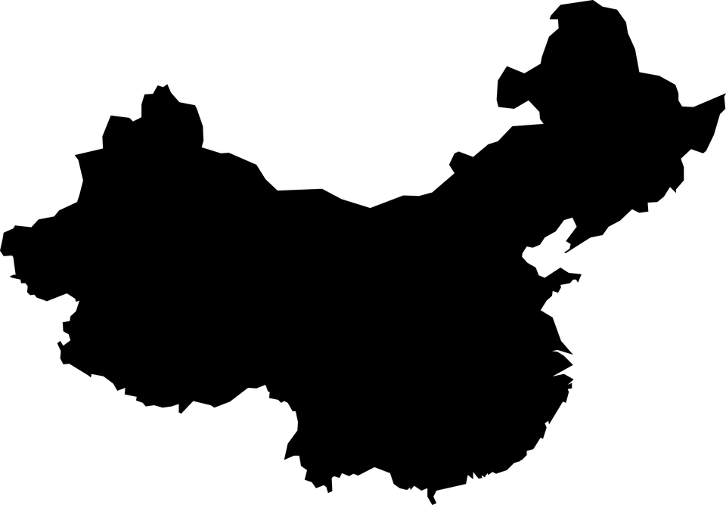





Nicholas II’s autocracy and the court: the 1905 Revolution
The Russian Tsar felt humiliated after the Asian defeat. The Baltic fleet was destroyed and the already limited supply of grain was further depleted.
Defeat in the Russo-Japanese War over control of China
1
Over 100 thousand workers went on a peaceful strike to protest their working conditions in the city. However, they were brutally suppressed by Russian soldiers. About 200 people were killed and the event became known as Bloody Sunday.
1905 Revolution
Bloody Sunday
(January 9, 1905)
2
Economic stagnation and hardships
Members of the peasantry experienced economic discontent due to rapid industrialisation and urbanisation.
3
CAUSE
4
Rise of political opposition
With the rise of Marxist ideology, many groups grew opposed to the Tsarist regime in Russia.

Slide 19
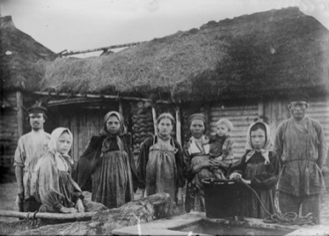
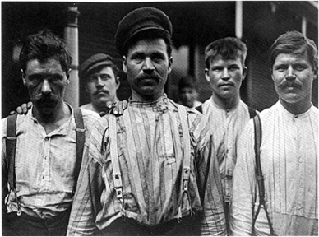
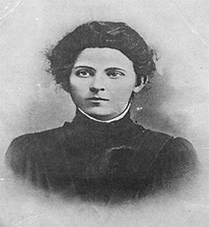
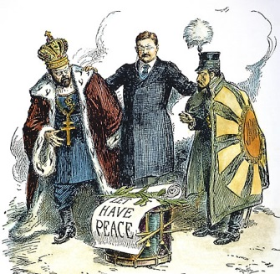
The 1905 Revolution
Make your own copy of this diagram
Poor harvests of 1900 and 1902
affected peasants
and food supplies
1902 Industrial slump- workers laid off/ strikes
Increasing pressure from
the Liberals and Middle Class. There was also the hostility and violence of the Social Revolutionary Party (SR)
Causes
Causes
Russo Japanese War 1904-1905: Russia thought she would win, fought over land in Manchuria. Led to shortages .Russia defeated. Humiliated. The war disrupted food supplies, causing shortages and prices to rise in the cities…
How did the Russo-Japanese war add to the tension in Russia? (p32-33)

Slide 20
Father Gapon’s Petition
1) Read Source below. Make two lists:
  A) The petitioners’ complaints –B) The petitioners’ demands
2) Are these demands revolutionary demands? Explain your answer.
3) Choose two words to sum up the attitude of the petitioners to the Tsar.
Lord, we workers, our children, our wives and our old, helpless parents have come, Lord, to seek truth, justice and protection from you.
We are impoverished and oppressed, unbearable work is imposed on us, we are despised and not recognised as human beings. We are treated as slaves, who must bear their fate and be silent. We have suffered terrible things, but we are pressed ever deeper into the abyss of poverty, ignorance and lack of rights.
We ask but little: to reduce the working day to eight hours and to provide a minimum wage of a rouble a day.
Officials have taken the country into a shameful war. We working men have no say in how the taxes we pay are spent.
Do not refuse to help your people. Destroy the wall between yourself and your people.
From the Petition to the Tsar presented by Father Gapon, 1905.

Slide 21
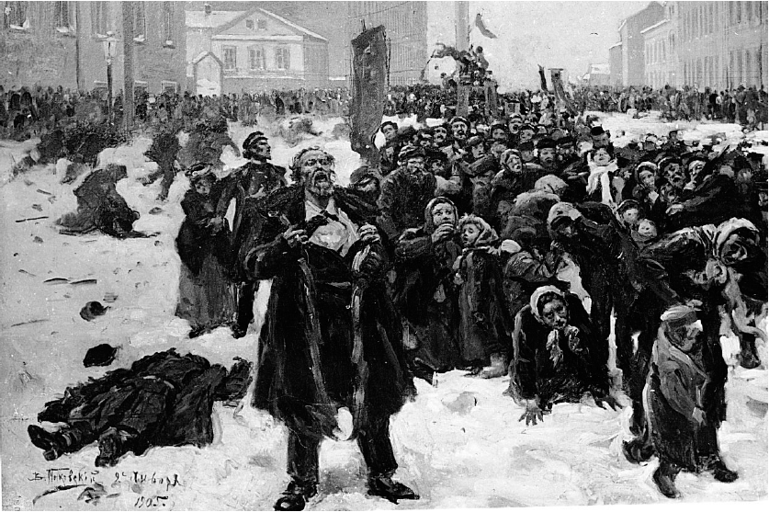
You are going to see four pictures of the event which triggered the 1905 revolution. Write down what you see and what you can infer from them

Slide 22
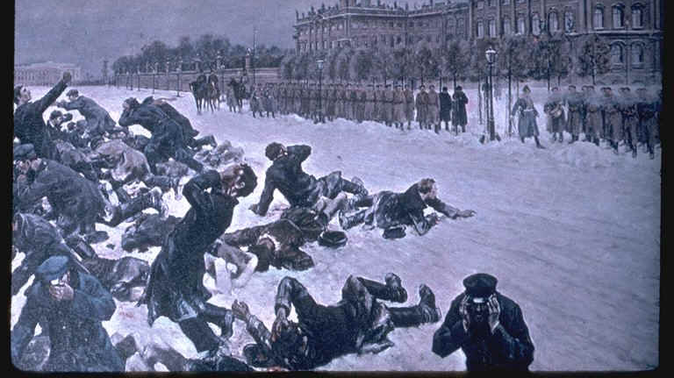

Slide 23
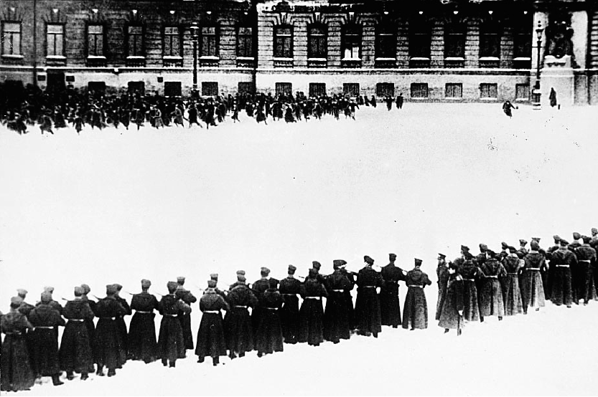

Slide 24
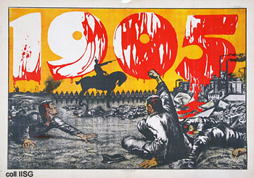

Slide 25
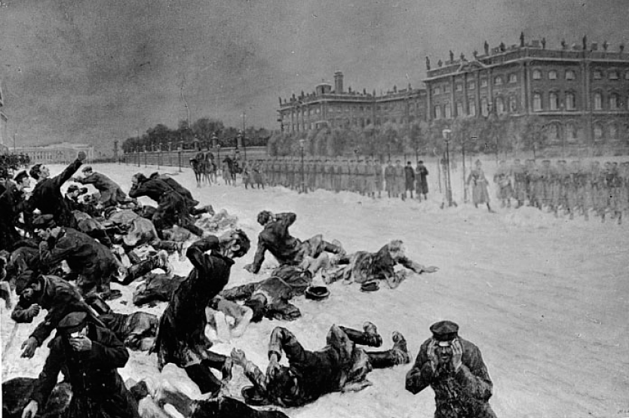
What do you think the event was in 1905 which triggered the revolution?
‘Bloody Sunday’ – 22 January 1905 a priest, Father Gapon, led 200,000 people to march on the Winter Palace to deliver a petition to the tsar.
They were met by troops who opened fire on the crowd. The number dead varies from 100 (official estimates) to thousands.
What questions do you still have about this event?
Painted in 1910
Painted in 1910
From a film made in the 1920s

Slide 26
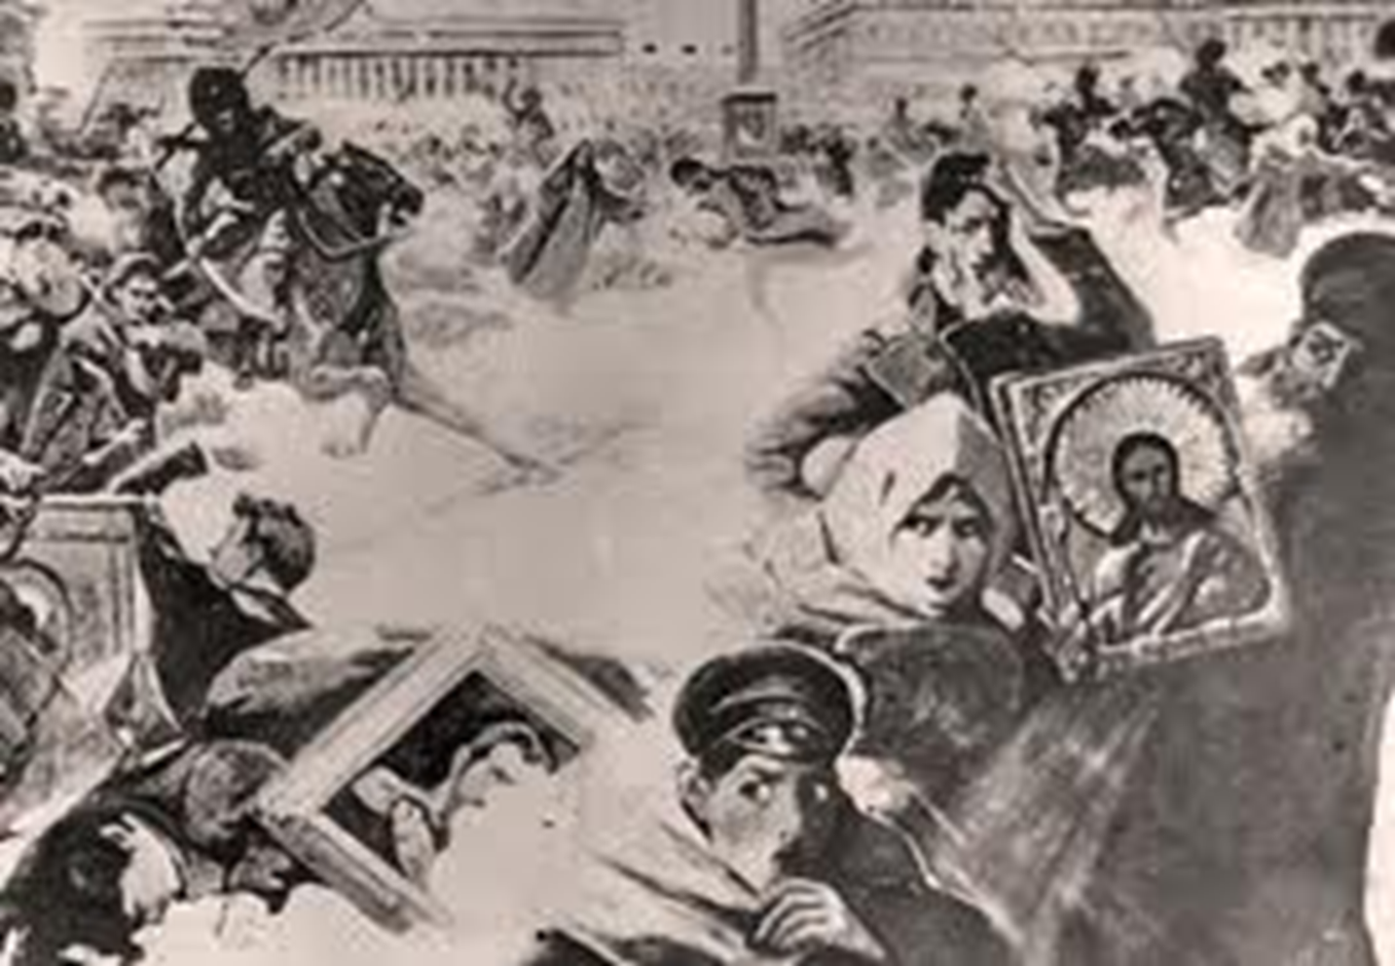
SOURCE A (handout)

Slide 27
Use source A and your own knowledge to describe Bloody Sunday
Look at your copy of the picture
Draw circles or arrows around at least 2 things you notice
What do they show and what can you infer from these?
Can you explain the features you have circled or give some background to explain what was happening at the time.
What effects did the events of Bloody Sunday have on the relationship between the Tsarist Govt and the Russian people?

Slide 28
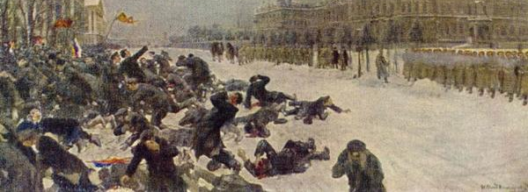
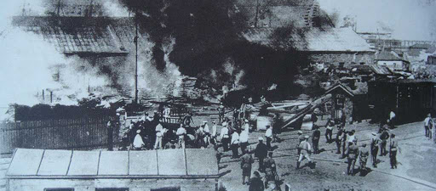
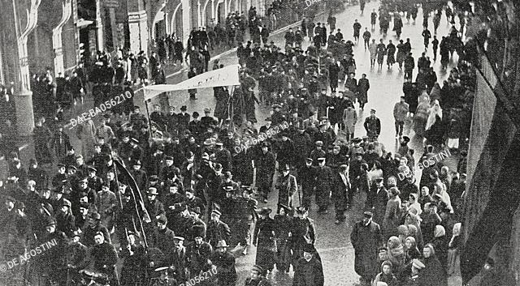
1905: A revolutionary year
Bloody Sunday itself was a dramatic and sudden event which acted as a catalyst for much of which was to follow.
However, it was inextricably linked to a longer term malaise and culture of discontent, repression and disenfranchisement which had been building for a while.
Reaction to the events of Bloody Sunday was similarly linked to wider anger and disillusionment at the Tsarist system; protests, strikes and political violence/assassinations spread wildly across Russia (hence the ‘Revolution’ part!)
Strikes paralysed the industrial centres, workers ‘soviets’ were formed (an important precedent for future!) demanding better working conditions and political rights
The Social Revolutionaries (SR) - successors of the ‘People’s Will’ - carried out campaigns of political terrorism and assassinations.
Peasants seized land and property across the countryside. The rule of law collapsed and chaos reigned
Non-Russian populations within the Empire (Poles, Armenians, Baltics etc) pressed for greater autonomy or in the case of Georgia declared independence from Russia.
Political opponents found greater voice and organisation and calls for reform/revolution grew. However one key group of Tsarist Russia remained loyal ….

Slide 29
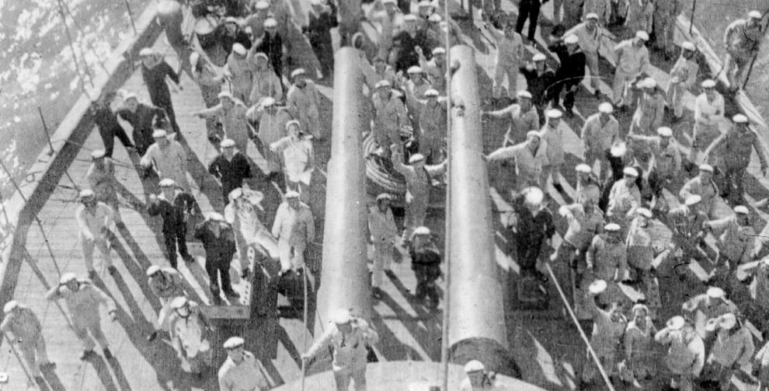
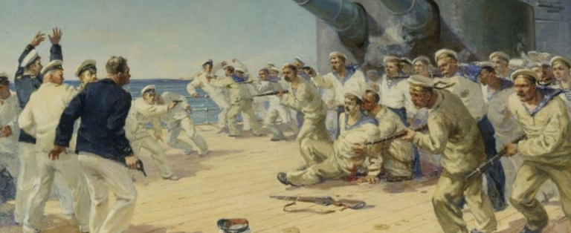
Potemkin Mutiny: The Tide is stemmed
Reeling from the humiliation of defeat to Japan, the Russian army and navy were in a fragile state of low morale and self-loathing in 1905.
As news of the growing protests reached garrisons and naval bases, soldiers and sailors (overwhelmingly peasants themselves) found natural empathy and support for the Revolution.
Conditions with the Imperial Army and Fleet were horrendous and inhumane for them too.
Mass outbreaks of mutiny and rebellion were avoided – with one exception.
In what had initially began as a protest over rotten food and sanitation, sailors of the Black Sea battleship Potemkin mutinied and overthrew their superiors in a desperate act to be listened to.
Shunned by their fellow ships, the Potemkin sailed for Odessa where serious unrest and strikes were taking place

Slide 30
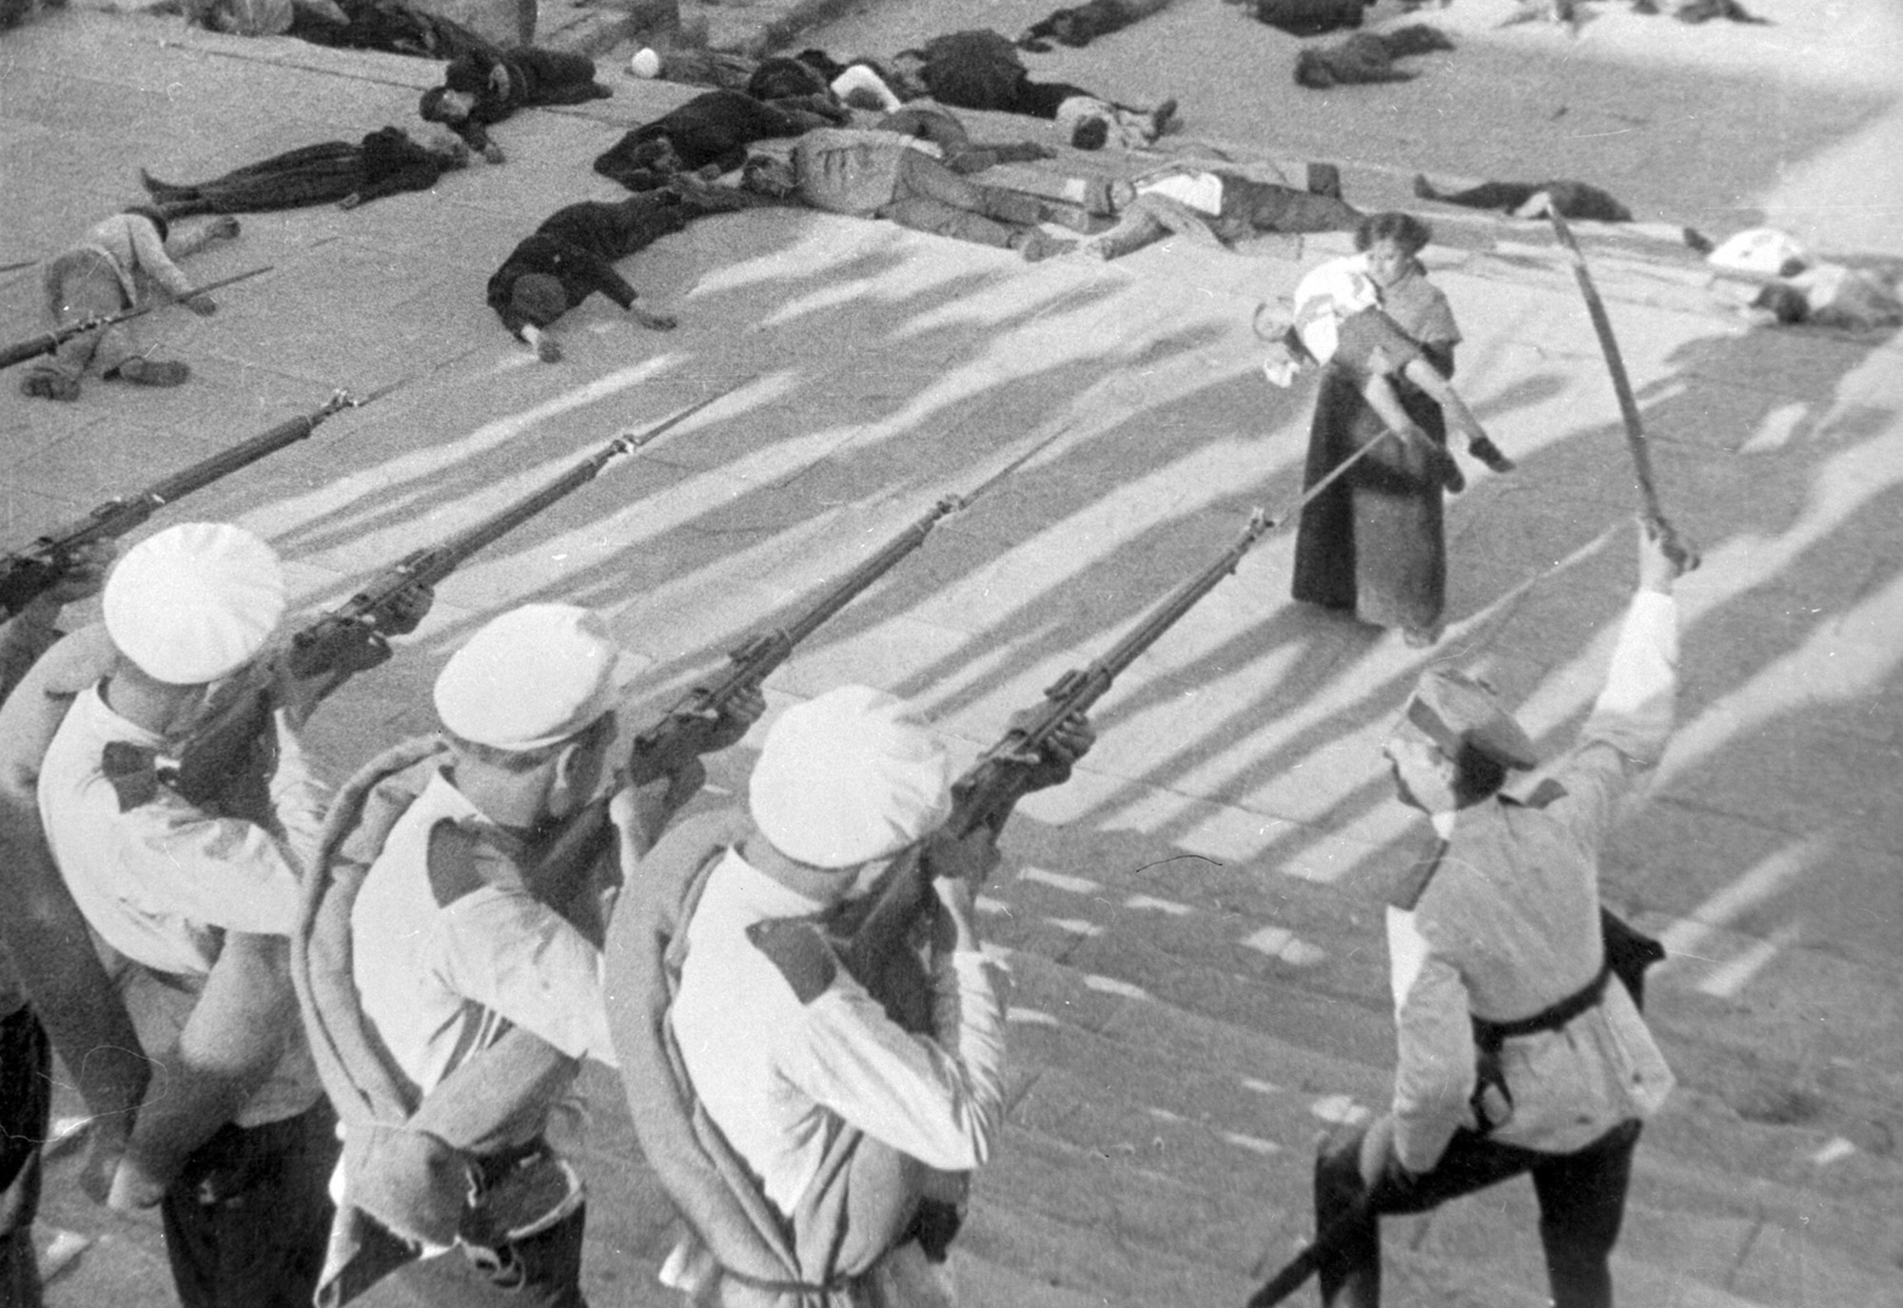
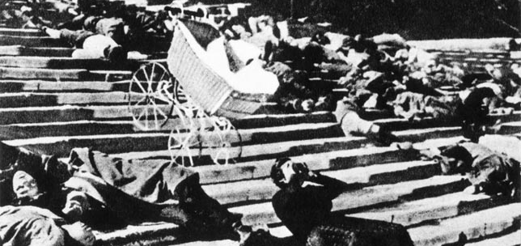
Potemkin Mutiny: A regime losing control
The inhabitants of Odessa welcomed the mutineers of Potemkin as heroes, and stood in solidarity with one another in protest at a corrupt, inhumane and disconnected regime
The sight of civilians and sailors uniting under a common cause of revolutionary protest enraged the authorities, who took quick and destructive action on the citizens of Odessa
With callous disregard for human life, troops dispersed crowds gathered on and around the famous harbour steps by firing indiscriminately at unarmed civilians then moving in with bayonets to finish the job.
The death toll ran to the thousands.
The battleship Potemkin avoided such a fate, and sailed round the Black Sea to find sanctuary in Romania.
Whilst the Tsar sat in blissful ignorance of events, his government were aware of the impending disaster at large. Something had to be done to placate the angry mob and stave off the likelihood that further troops and sailors returning from the Pacific would also mutiny

Slide 31
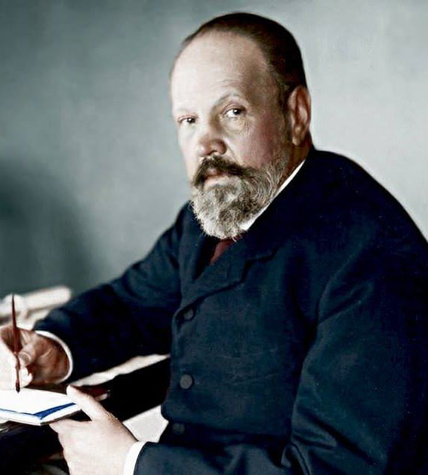
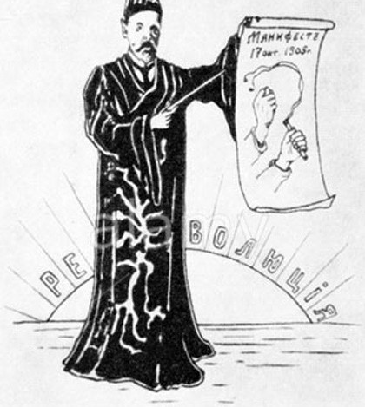
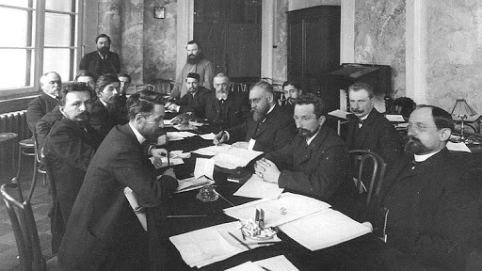
A sticking plaster over a deep wound: August Manifesto
Sergei Witte – he of economic reform and development fame in the 1890s – was summoned back to the forefront of the Tsar’s government to deal with the critically out of control situation.
Witte - a man with vision, pragmatism and diplomacy – described the Tsarist govt of 1905 as a ‘mixture of cowardice, blindness and stupidity.’ Yet he also felt a duty to Russia and to his Tsar and did the best he could in a maelstrom of incompetence and confusion surrounding him.
Witte persuaded the Tsar into signing off on the August Manifesto, which indicated a step towards a democratic process in the establishment of a state assembly of all 51 provinces.
However the Tsar stopped short - much too short for most Russians – of granting any real sense of enfranchisement of the Russian people and the August Manifesto served to pour more fuel on the fire than achieve any degree of rapprochement.
By October the situation had deteriorated further. A general strike crippled Russia and the government faced the real threat of soviet insurrection becoming unstoppable

Slide 32
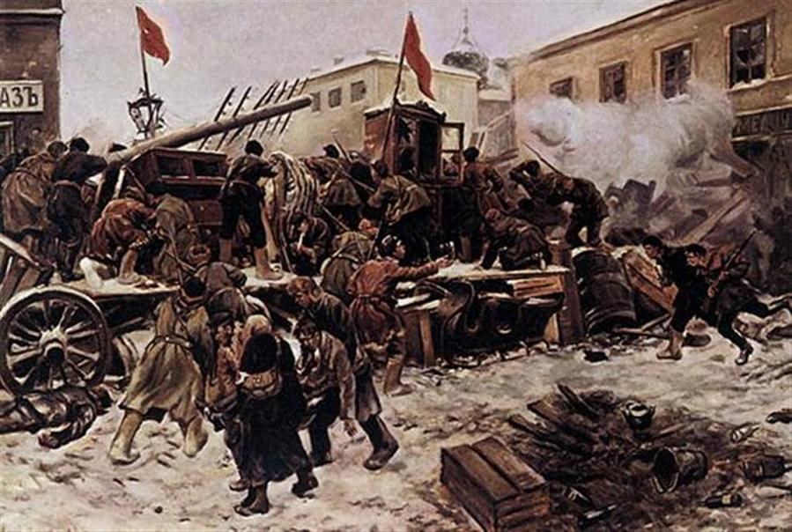
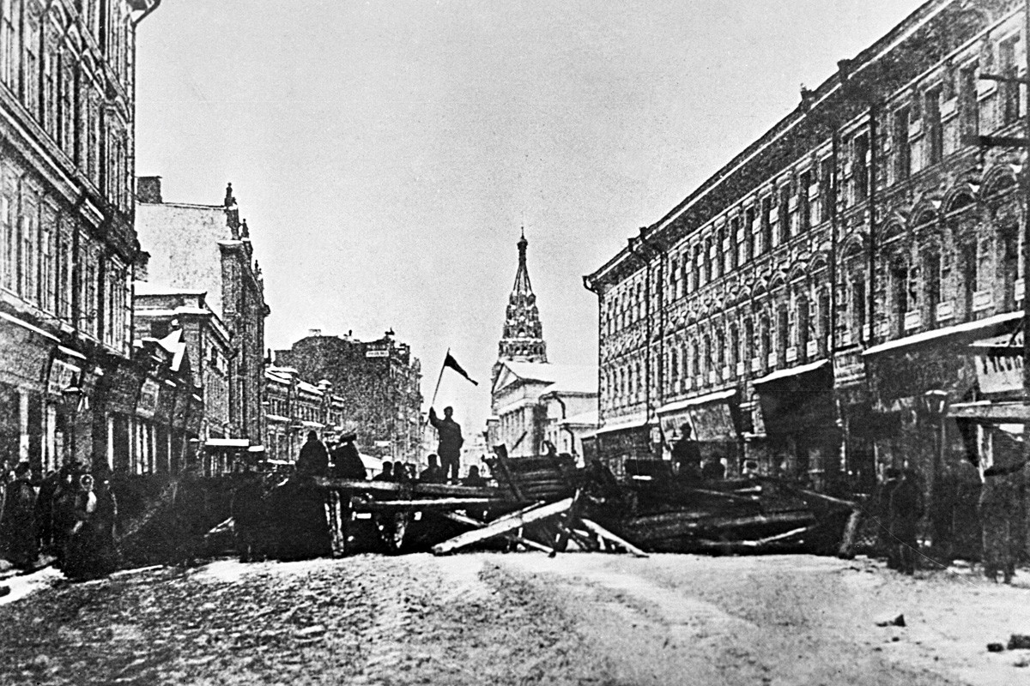
October Days & Crushing the Soviets
Liberals were appeased through the promise of a legislative assembly (the Duma), freedom of speech and voting rights. They were the main ‘victors’ of the 1905 Revolution, on paper at least
Peasants were won over through promises of a reduction in their crippling mortgage repayments and a planned general amnesty later on. Land seizures were given back and a sense of normality returned to the countryside
That left the industrial workers, who’s violence and organisation had struck fear into both the Tsarist elites as well as the liberal middle class (Similar to Germany 1848!).
With the army now stabilised after its humiliation in the Far East, they were used against their own people and the nascent Soviet movement in Moscow and St Petersburg was crushed ruthlessly. For now at least!

Slide 33
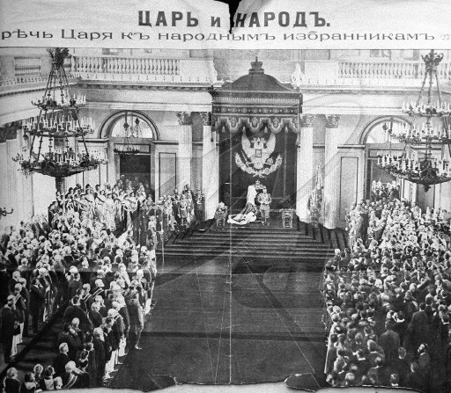
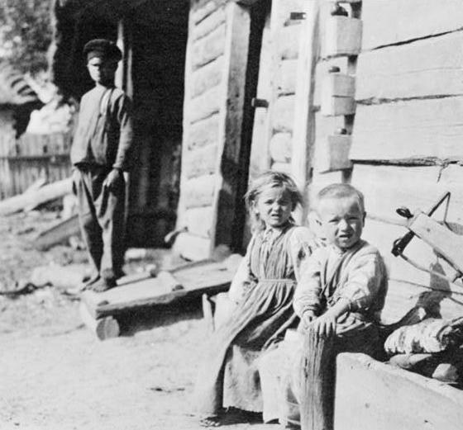
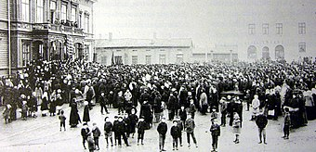
October Days & Crushing the Soviets
Liberals were appeased through the promise of a legislative assembly (the Duma), freedom of speech and voting rights. They were the main ‘victors’ of the 1905 Revolution, on paper at least
Peasants were won over through promises of a reduction in their crippling mortgage repayments and a planned general amnesty later on. Land seizures were given back and a sense of normality returned to the countryside
That left the industrial workers, who’s violence and organisation had struck fear into both the Tsarist elites as well as the liberal middle class (Similar to Germany 1848!).
With the army now stabilised after its humiliation in the Far East, they were used against their own people and the nascent Soviet movement in Moscow and St Petersburg was crushed ruthlessly. For now at least

Slide 34
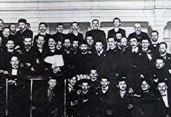
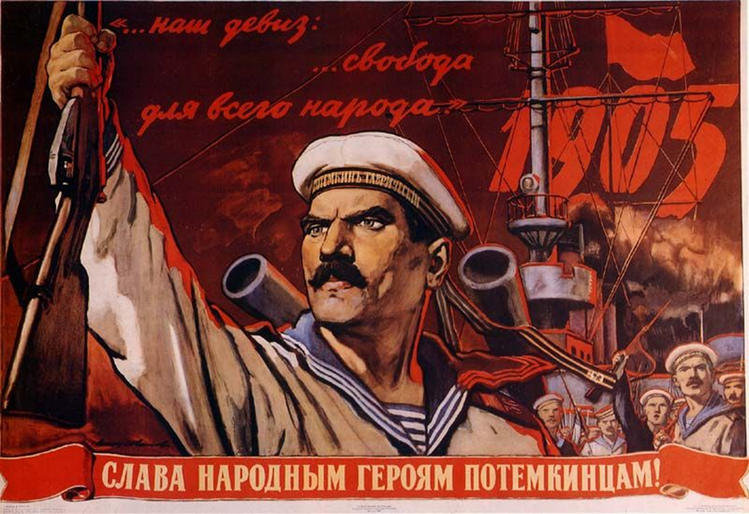
1905: A ‘Revolution’ in the truest sense of the word?
Historians have argued over the merits and value of the events of 1905 as constituting a serious ‘revolution’
With hindsight the events were too spontaneous, disorganised and disparate in the aims of the various groups agitating for change for it ever to have had a real chance of succeeding
However the very nature of so many complaints and grievances coming to the boil at exactly the same time indicated the breadth and depth of the failings of the Tsarist system.
There was a disconnect between the middle and working classes, city and countryside, which contributed to the failure to spark a cohesive unified front against the Tsar. The liberals also were quick to back down once some concessions were made.

Slide 35
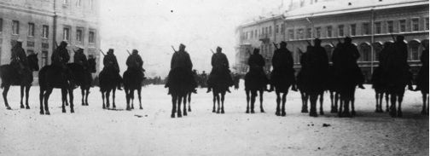
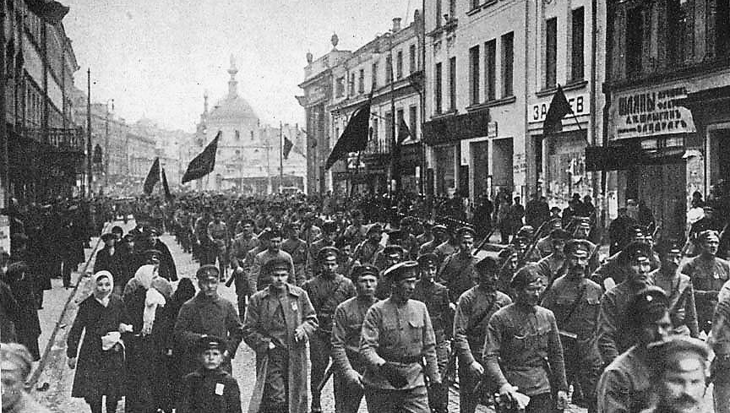
1905: A ‘Revolution’ in the truest sense of the word?
The army proved critical in dousing the flames of rebellion. As long as they remained loyal to the Tsar, successfully carrying out a revolution across the vast expanses of Russia would always be difficult.
However, ideals of revolution and change were kept burning away due to Tsarist arrogance and reactionary backlash in the Fundamental Laws of 1906, which straight away reaffirmed that ‘supreme autocratic power belongs to the Tsar.’ The embers of revolution would never go away with such attitudes.

Slide 36
Unit Review Tasks
How revolutionary were the revolutionaries?! Create a mind map as outlined below:
Answer refresher Q’s p.43
How revolutionary were the ‘revolutionaries’ of 1905?

Slide 37
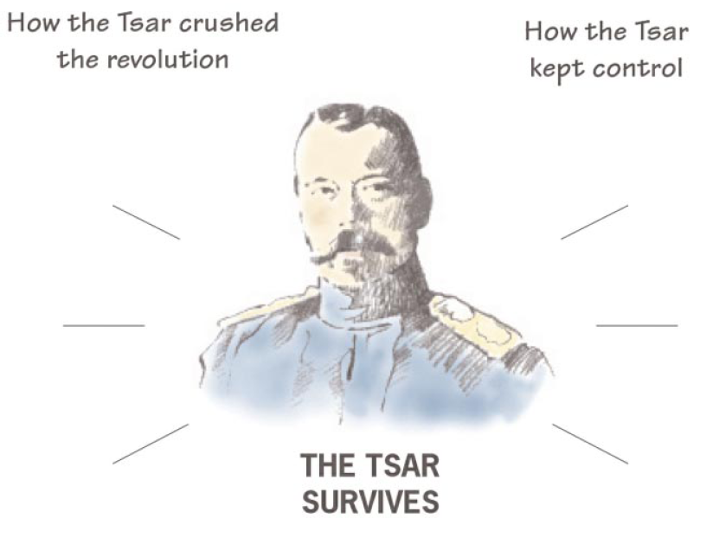
1. Copy this diagram.
2. Use your class notes and the textbook to fill in this diagram. On the left hand side list the different steps the tsar took to crush the revolution in 1905 & explain how each step helped him.
3. On the right-hand side, list the longer term measure the tsar took to keep control after the revolution & explain how each measure helped him.
Concessions to the Liberals – October Manifesto; Duma -> regained support of the MC.
Fundamental Laws – restored autocratic powers
Extension: ‘The tsar survived the 1905 revolution more because his opponents were ineffective than because he acted effectively himself.’
- Try and find evidence/examples to support and disagree with this view.
Send troops to dissolve first Duma after 75 days
Ended redemption payments for peasants
Tsar changes the voting system so the richest 1% elected 2/3 of representatives.
Used troops to shut down St Petersburg Soviet and arrested its leaders; Crushed Moscow Soviet
Stolypin’s repression and reforms

